Slide 1
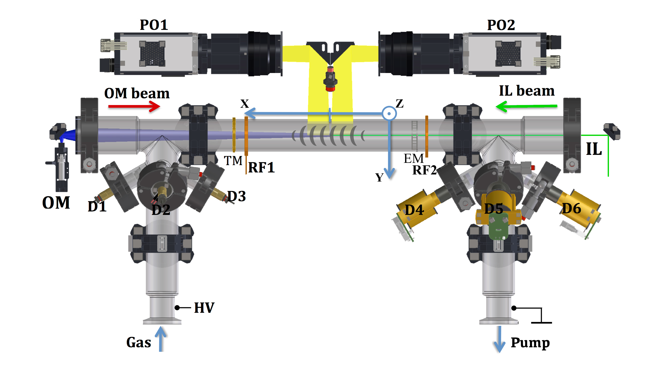
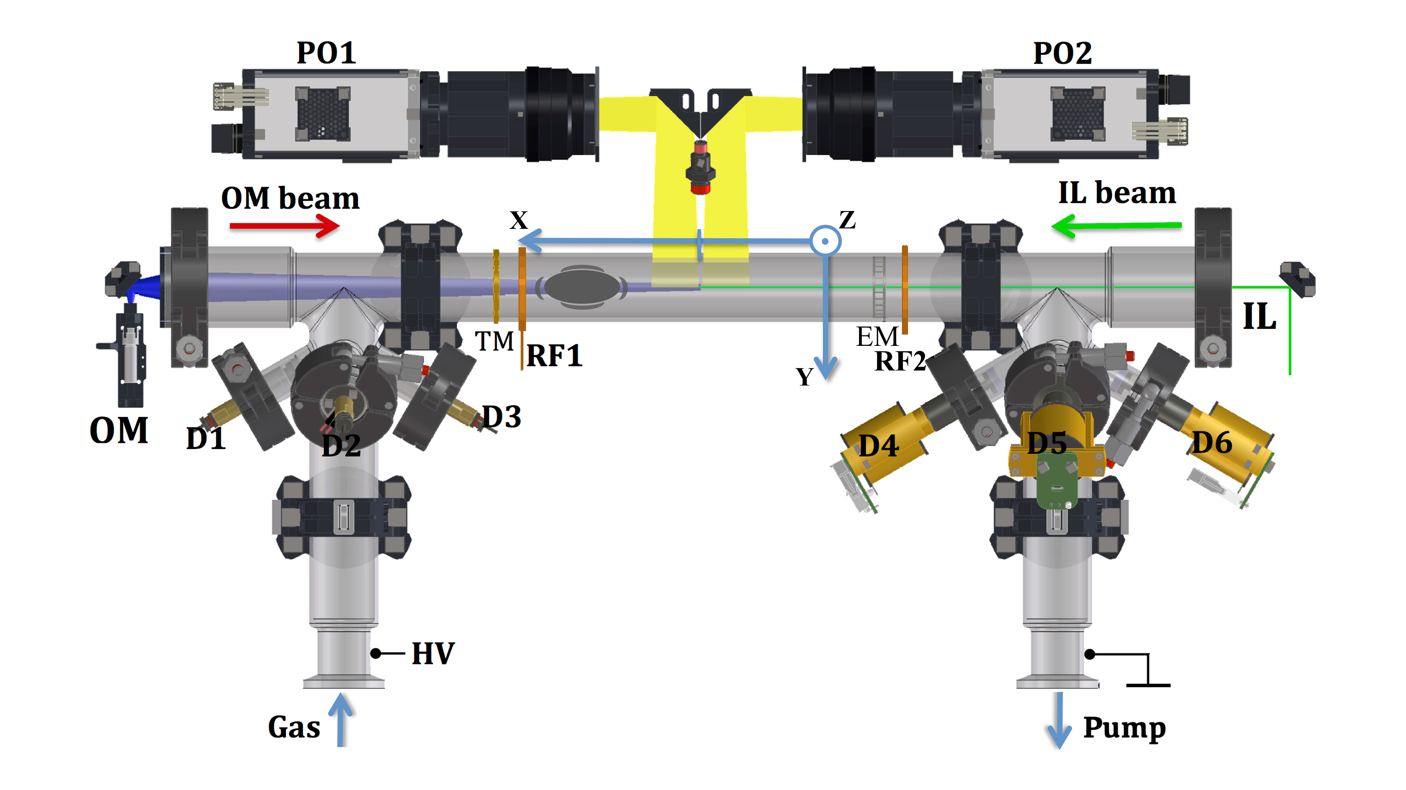

Introduction
1.
1b.
2.
2b.
Forward (F)
Backward (B)
I = - 0.5 mA
I = 0.5 mA

Slide 2
Introduction
V_group
Forward (F)
Backward (B)
I = - 0.5 mA
I = 0.5 mA

Slide 3
Introduction
C_daw = v_group – v_phase_measured
V_group
Forward (F)
Backward (B)
I = - 0.5 mA
I = 0.5 mA

Slide 4
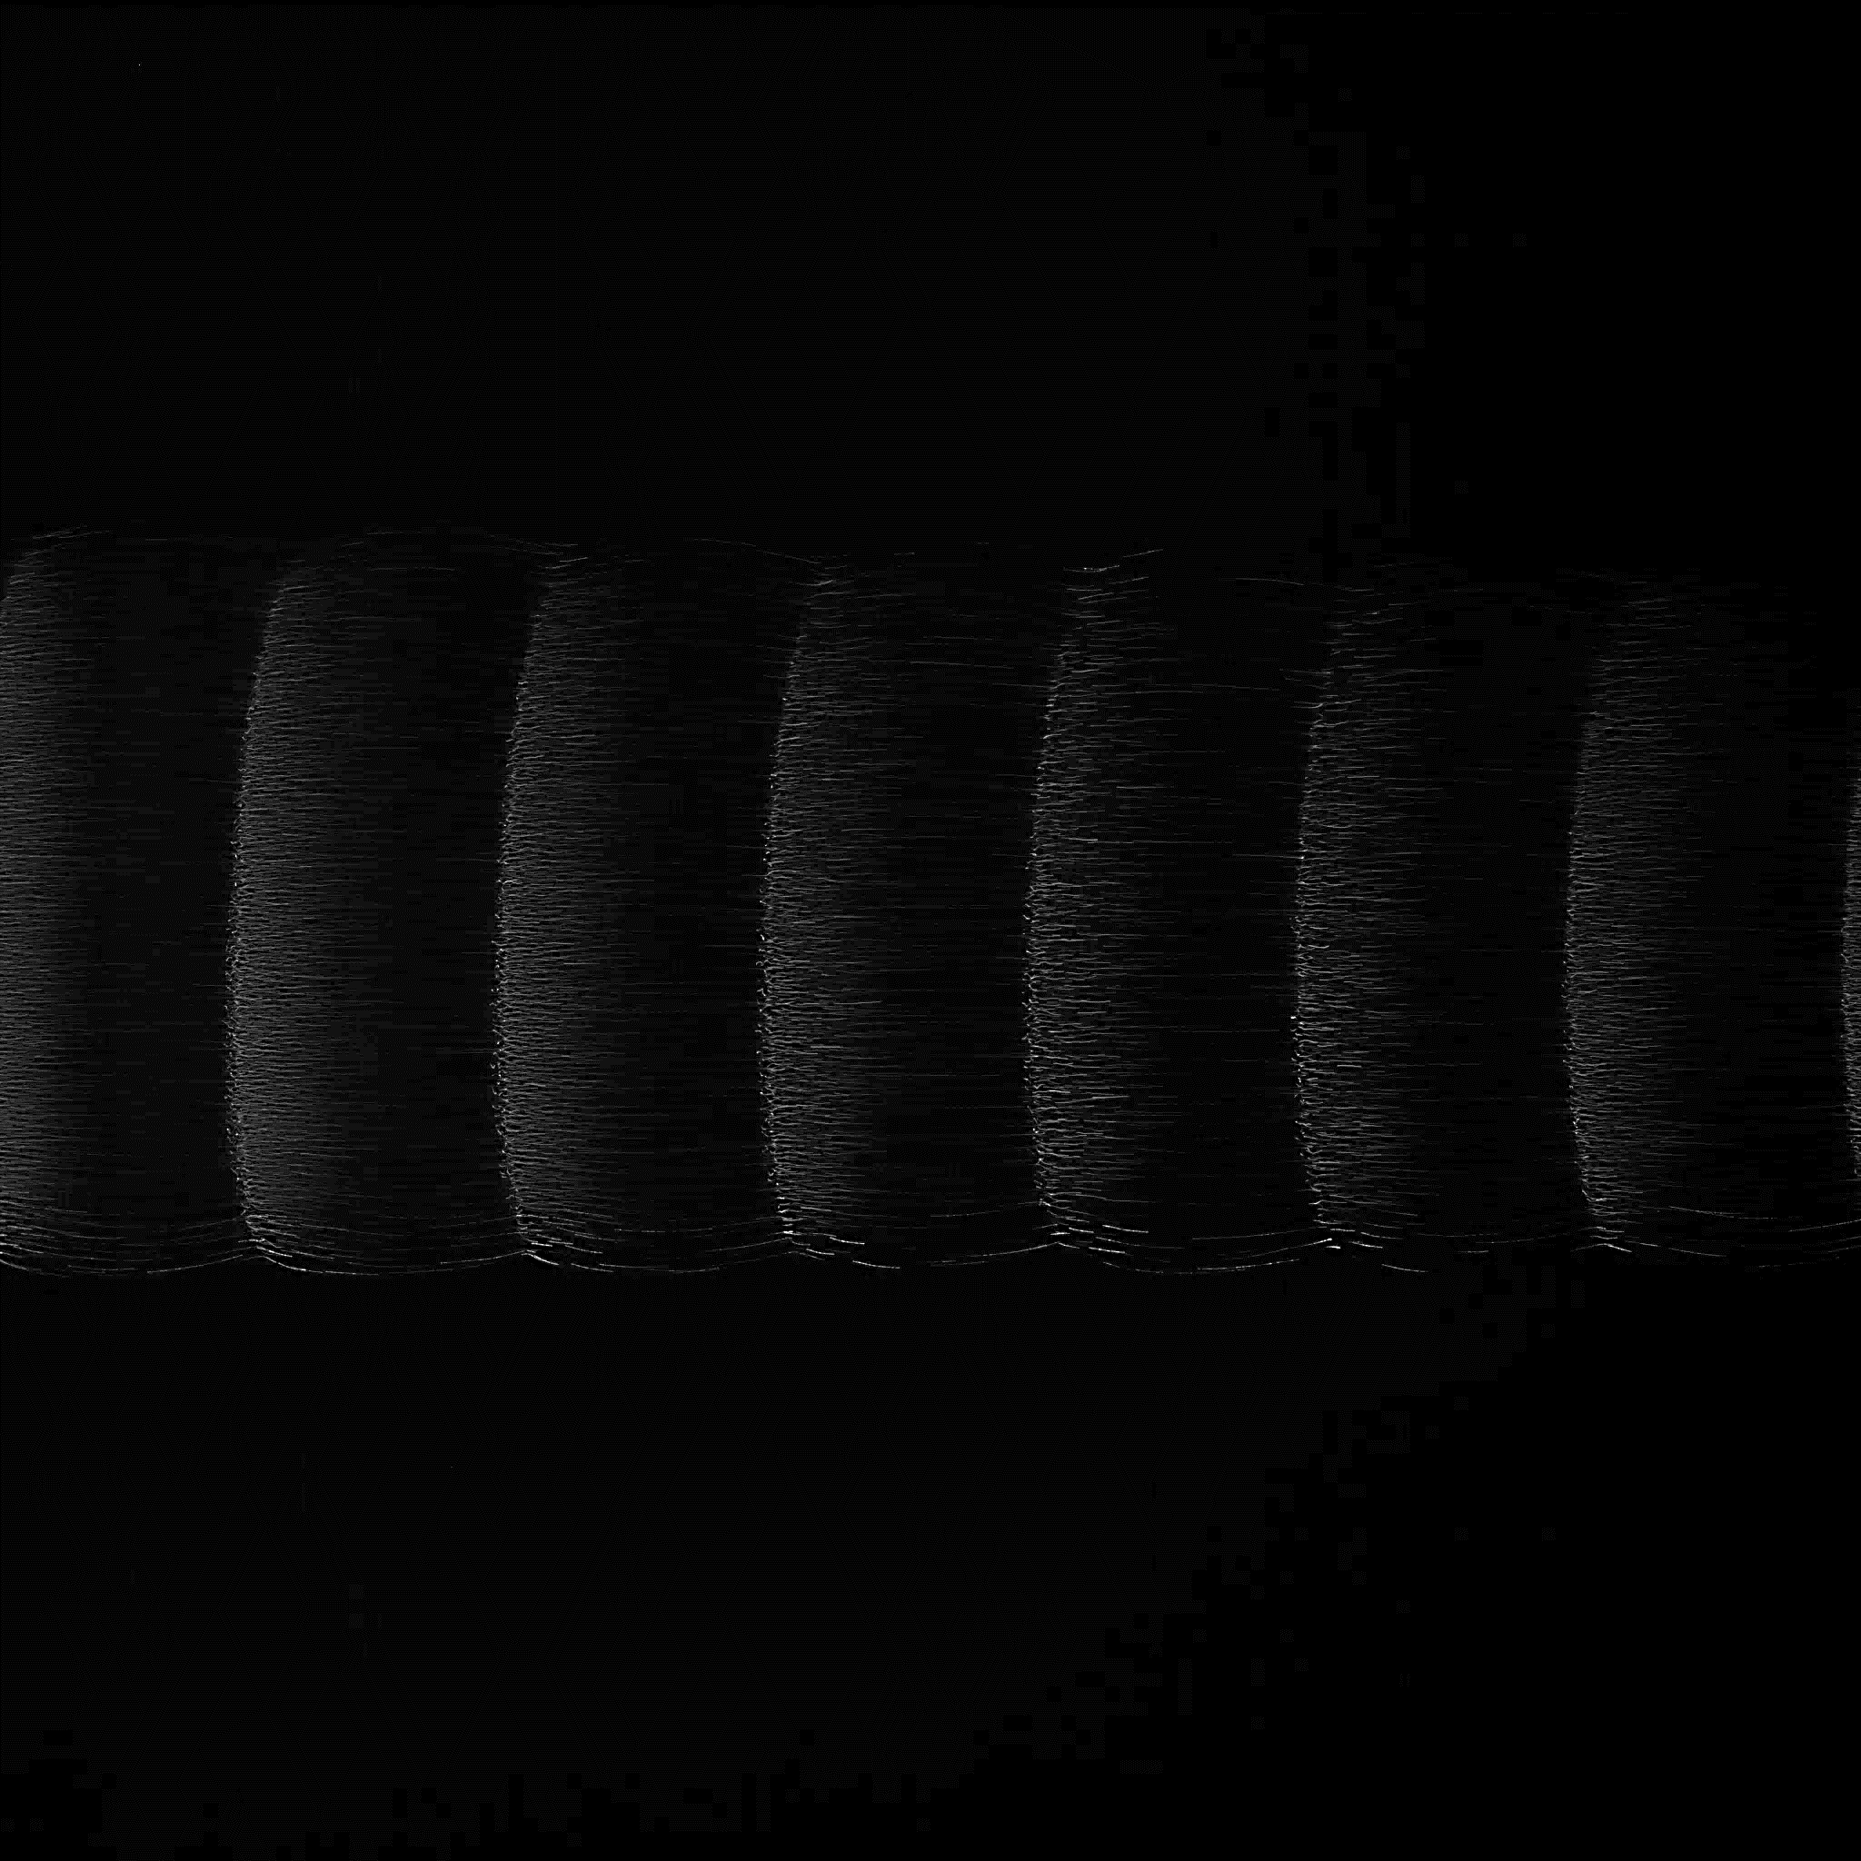
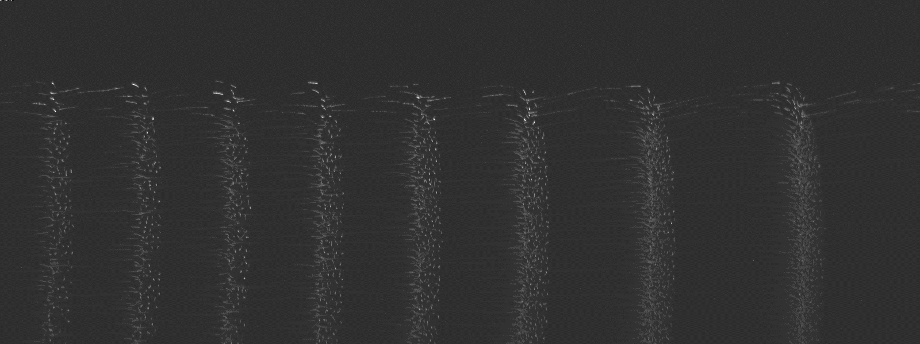
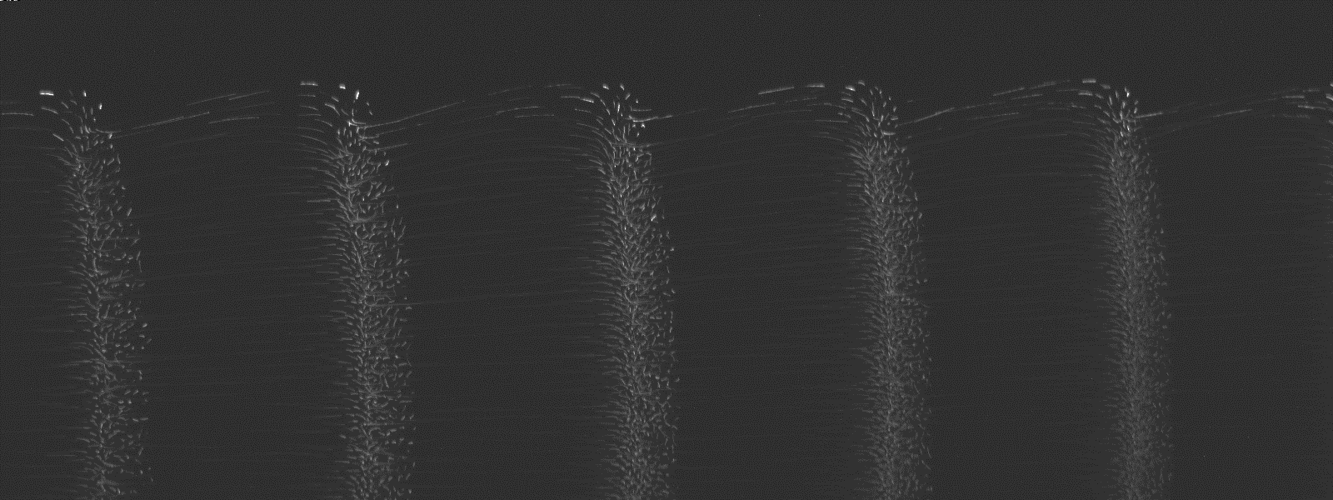
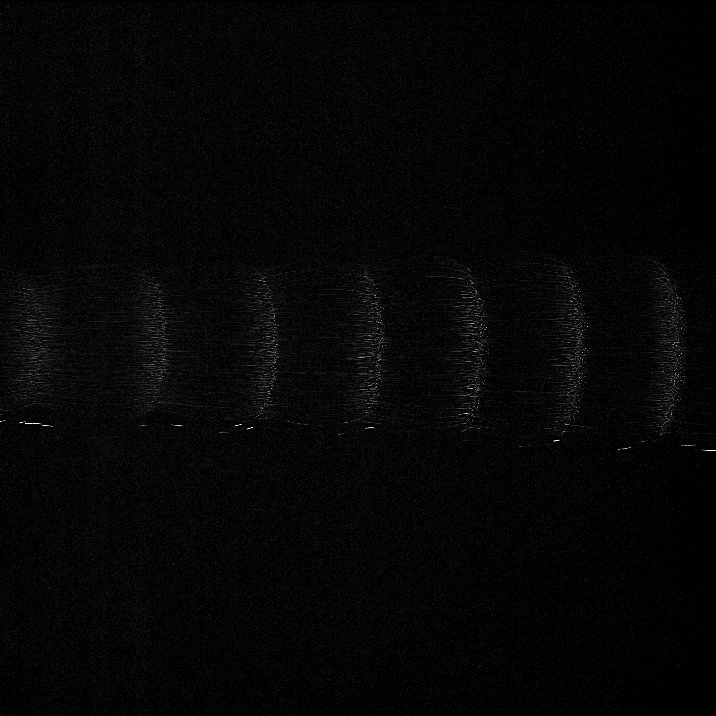
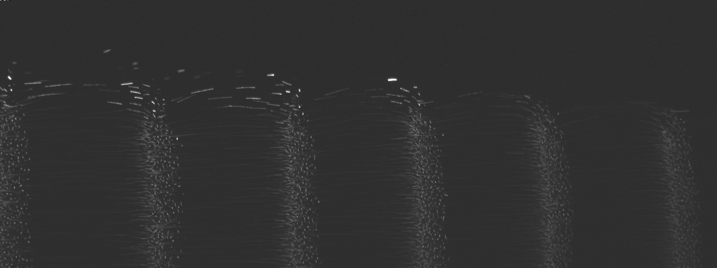

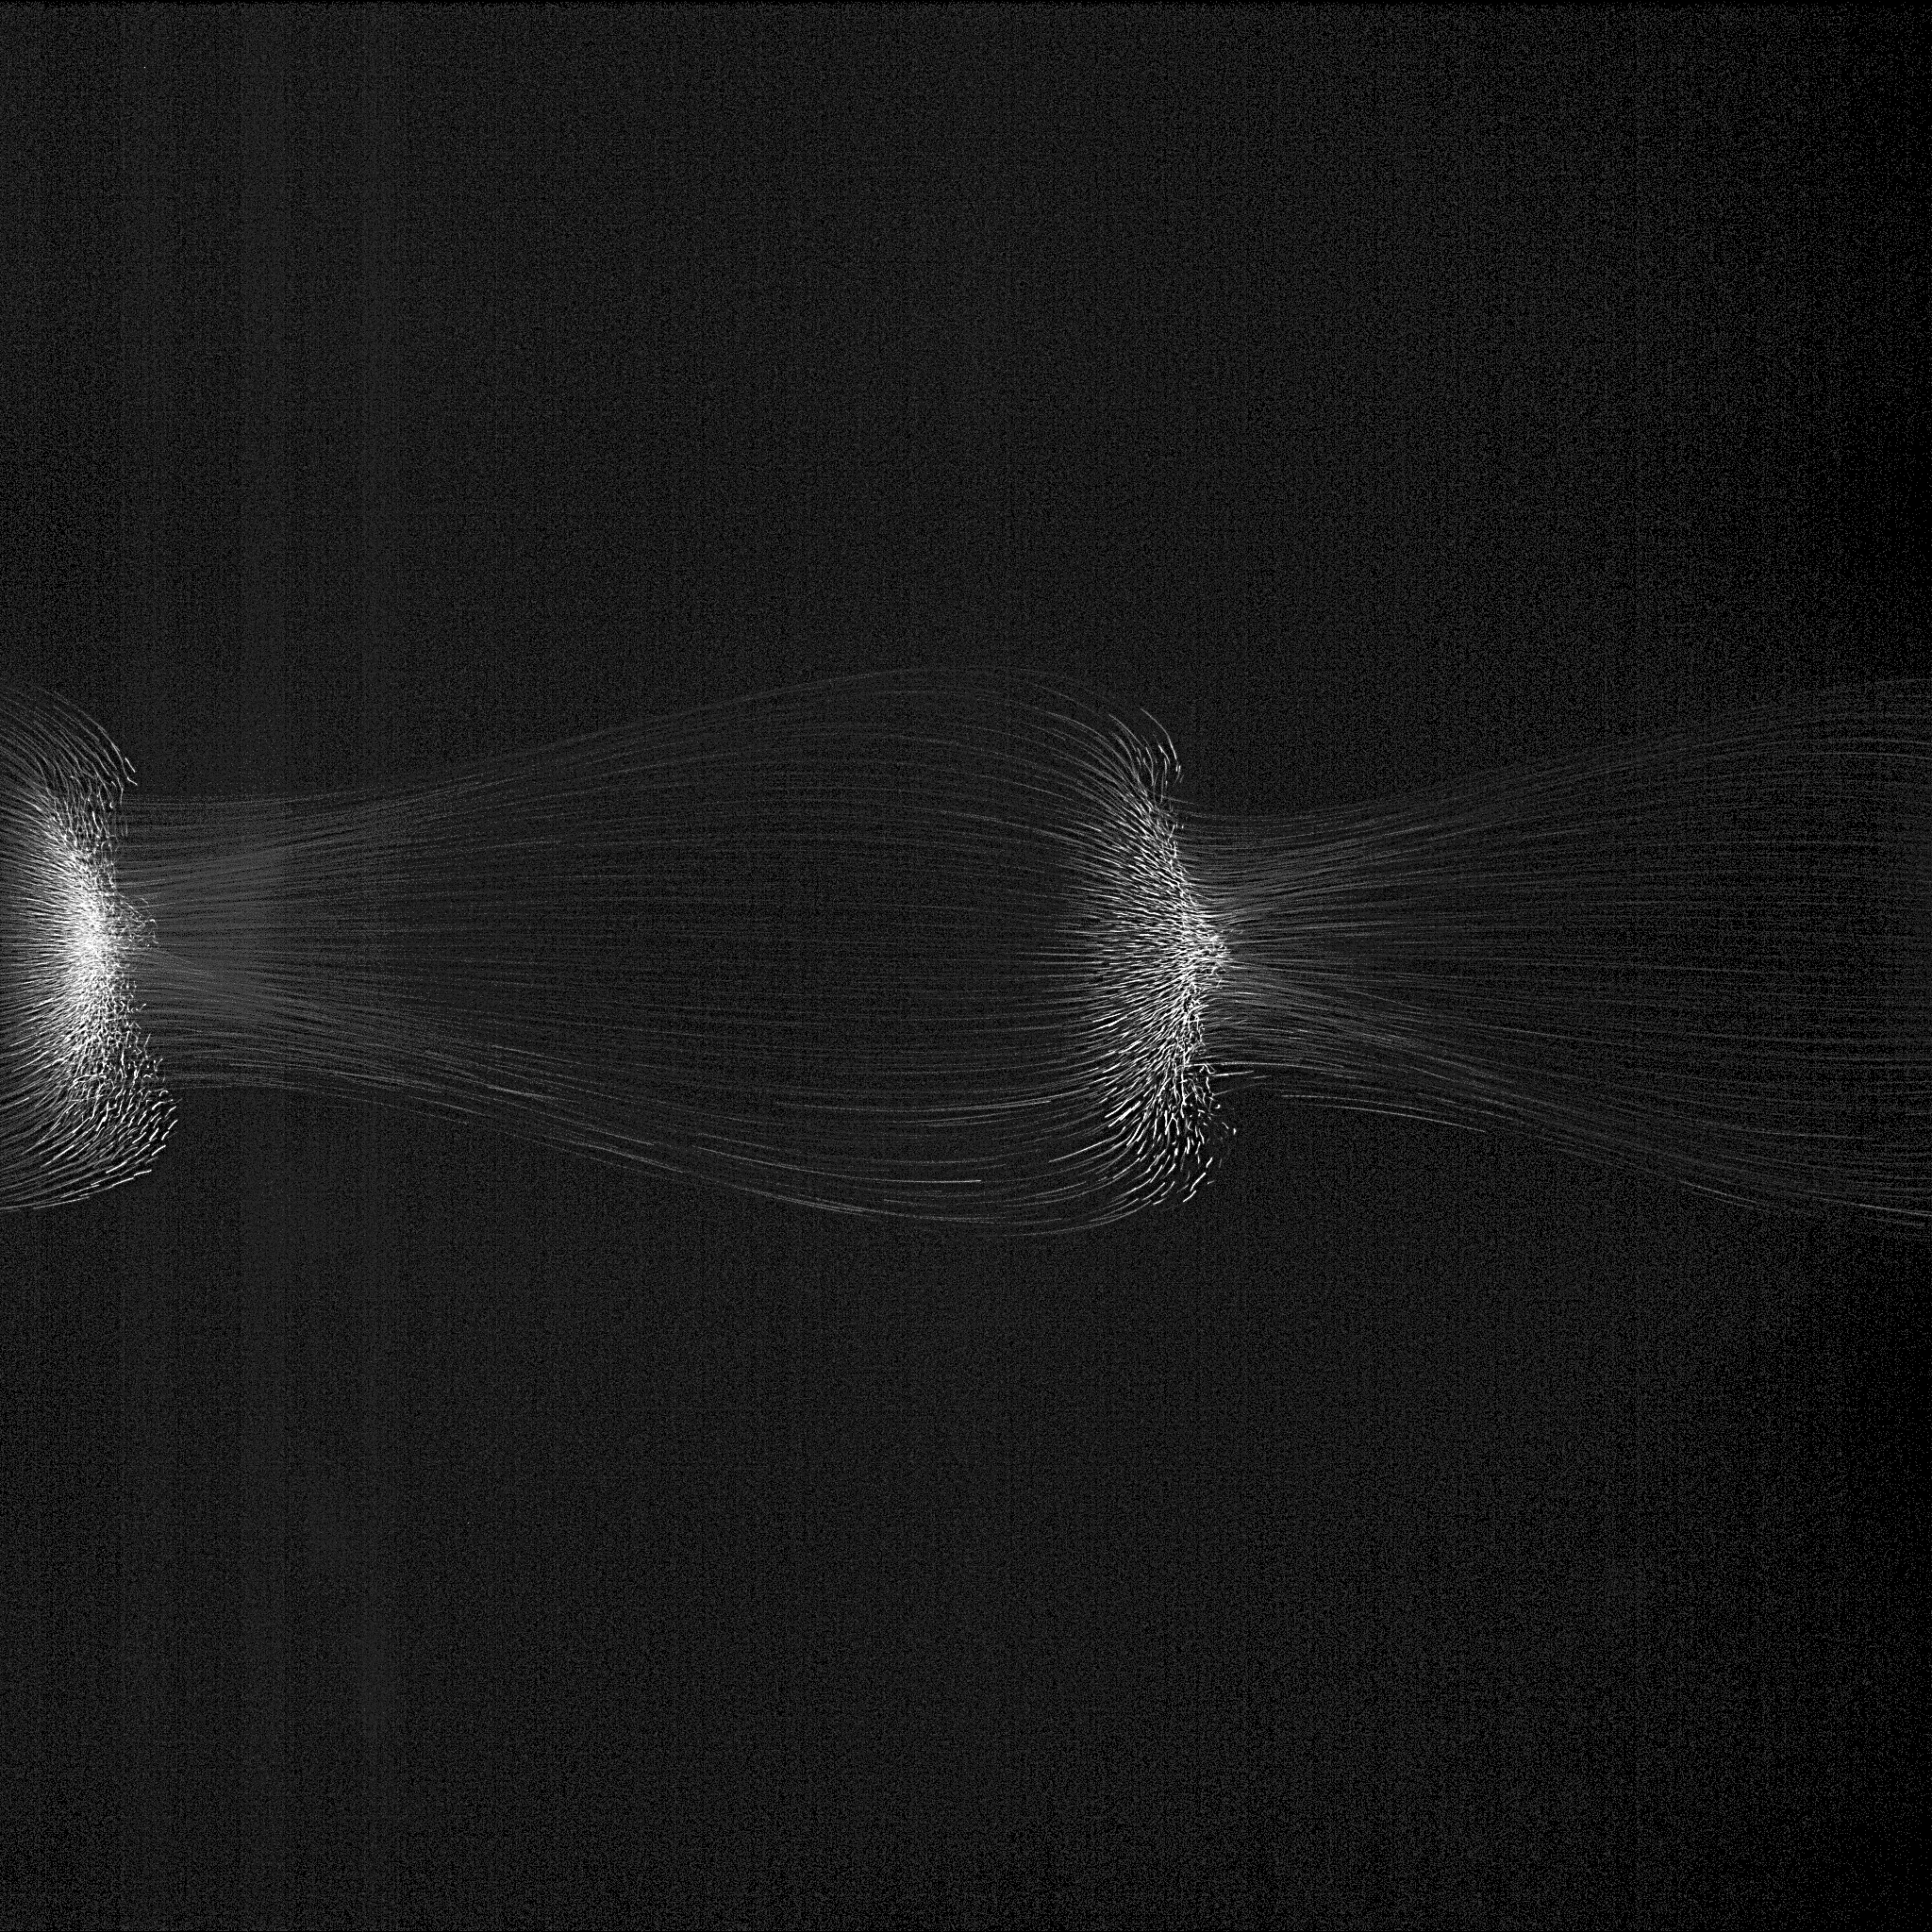
2 mm
PFC
40 Pa
2 mm
ISS
30 Pa
25 Pa
20 Pa
15 Pa

Slide 5
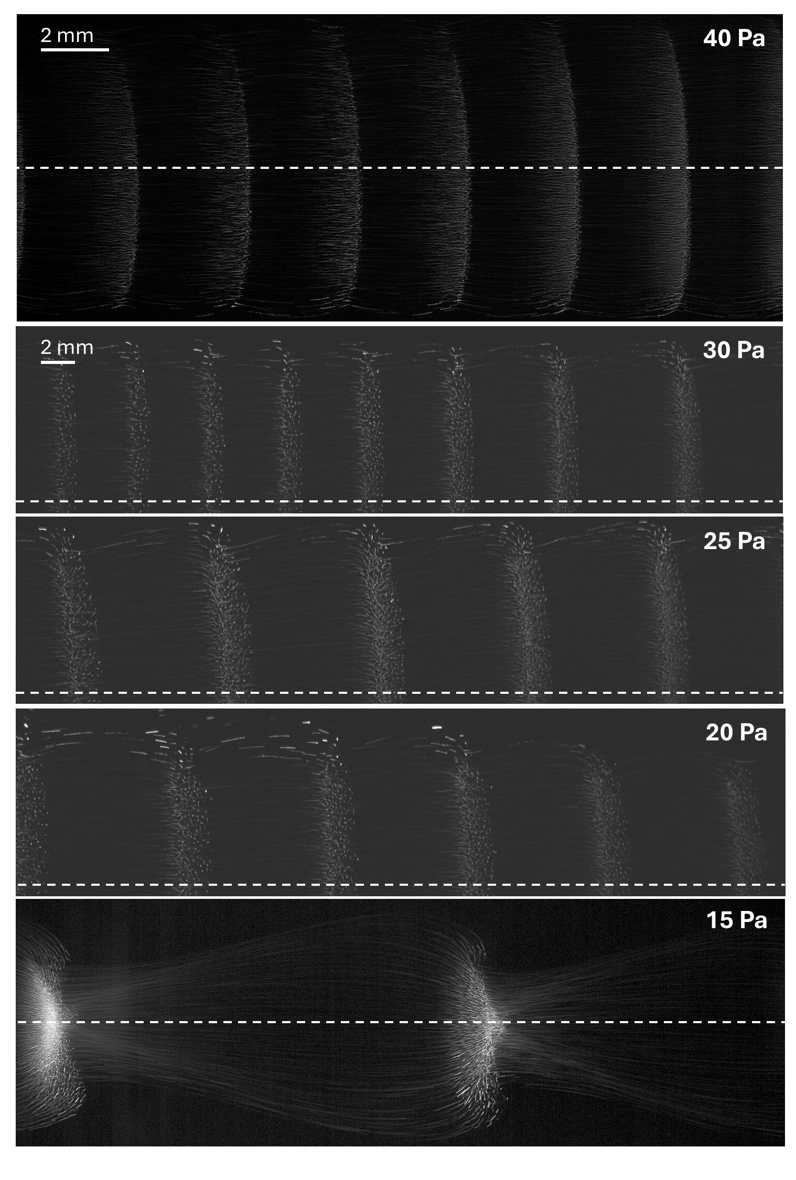
PFC
ISS

Slide 6
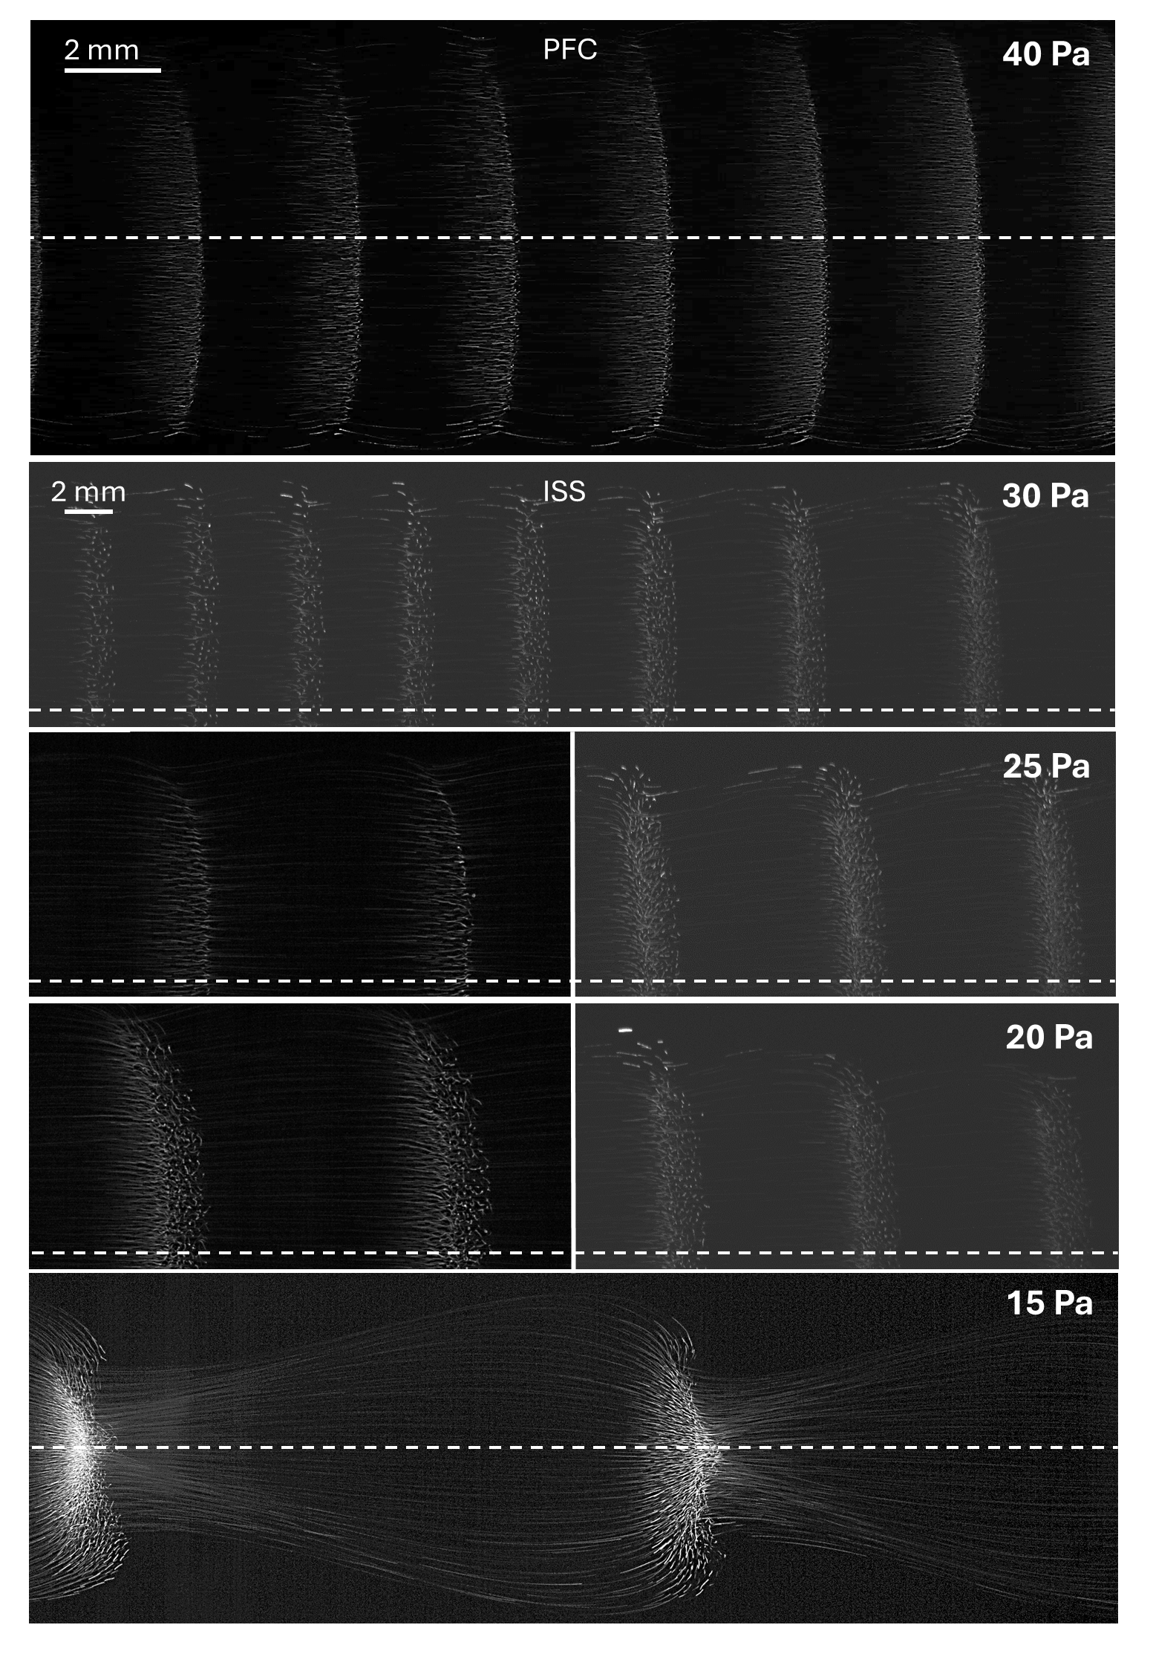

Slide 7
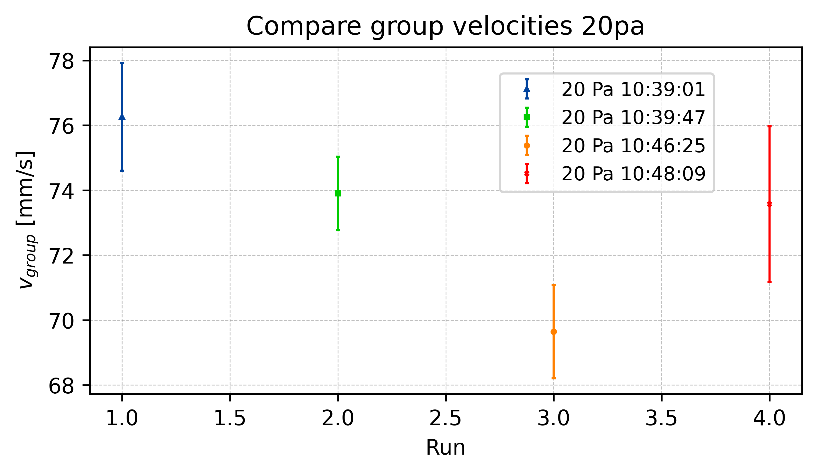
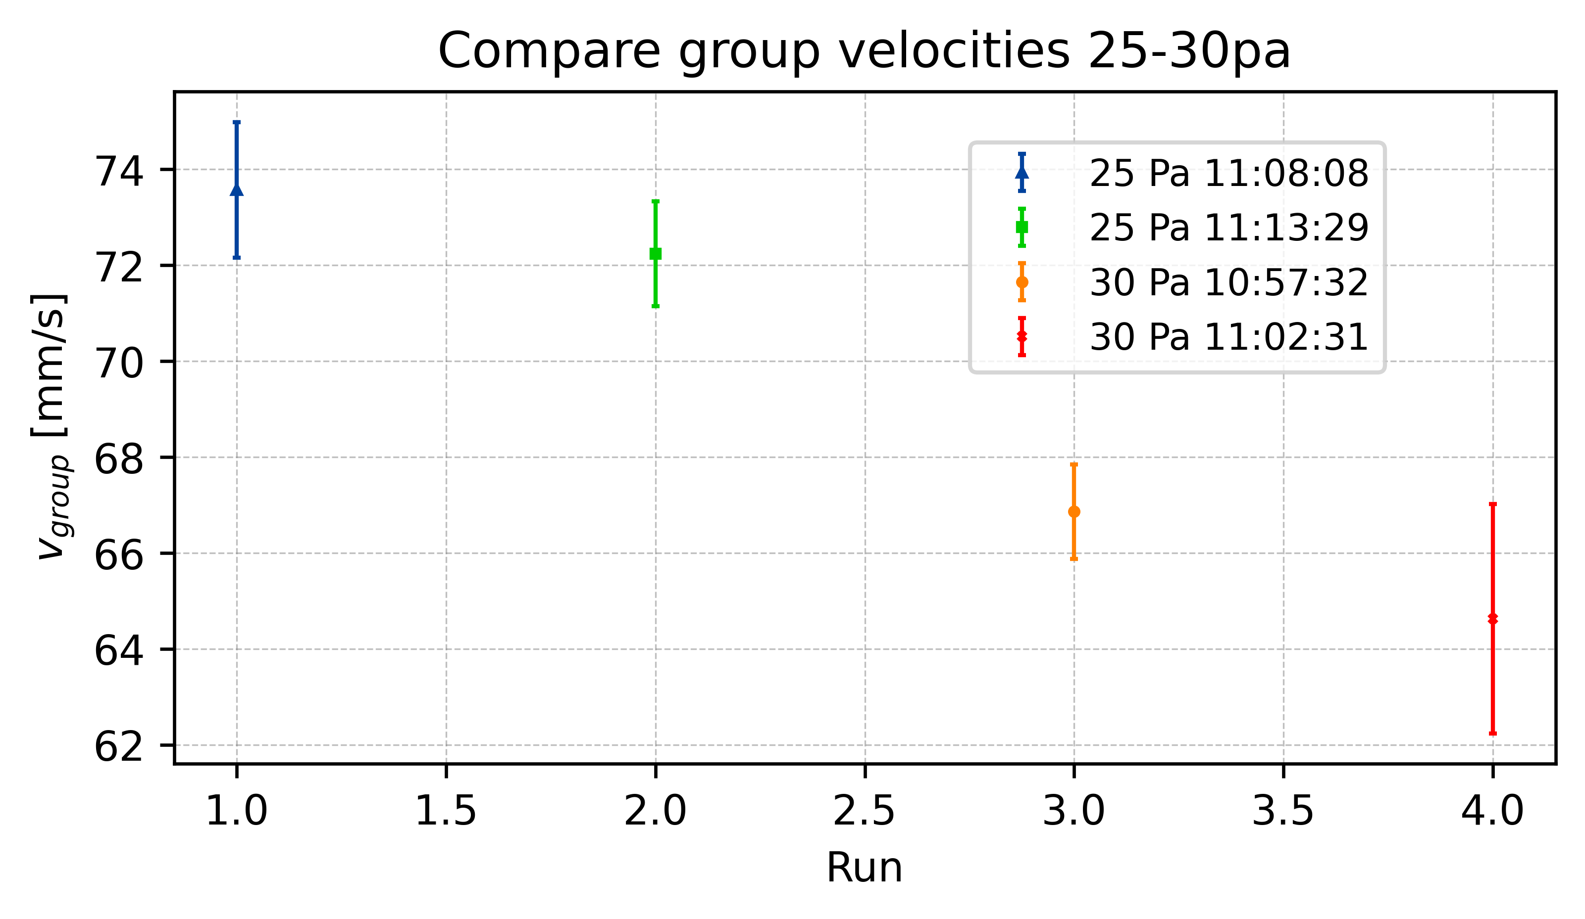
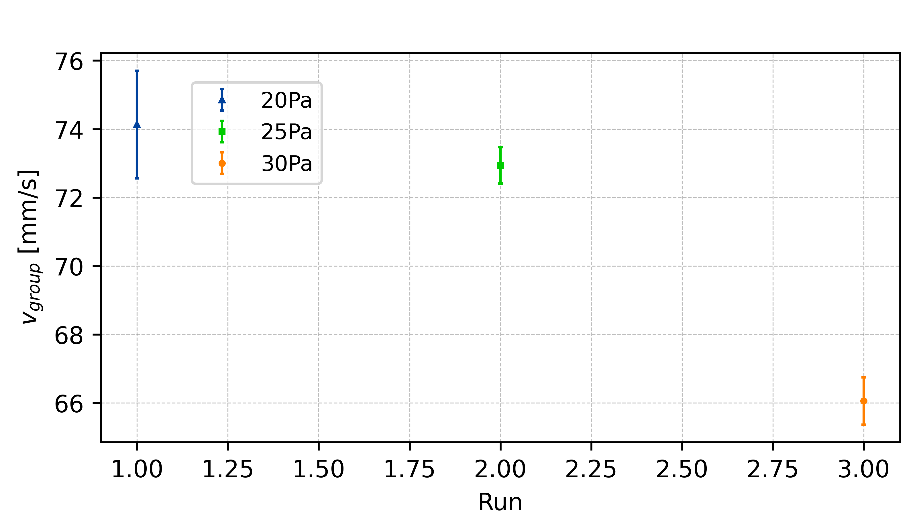
Group Velocity

Slide 8
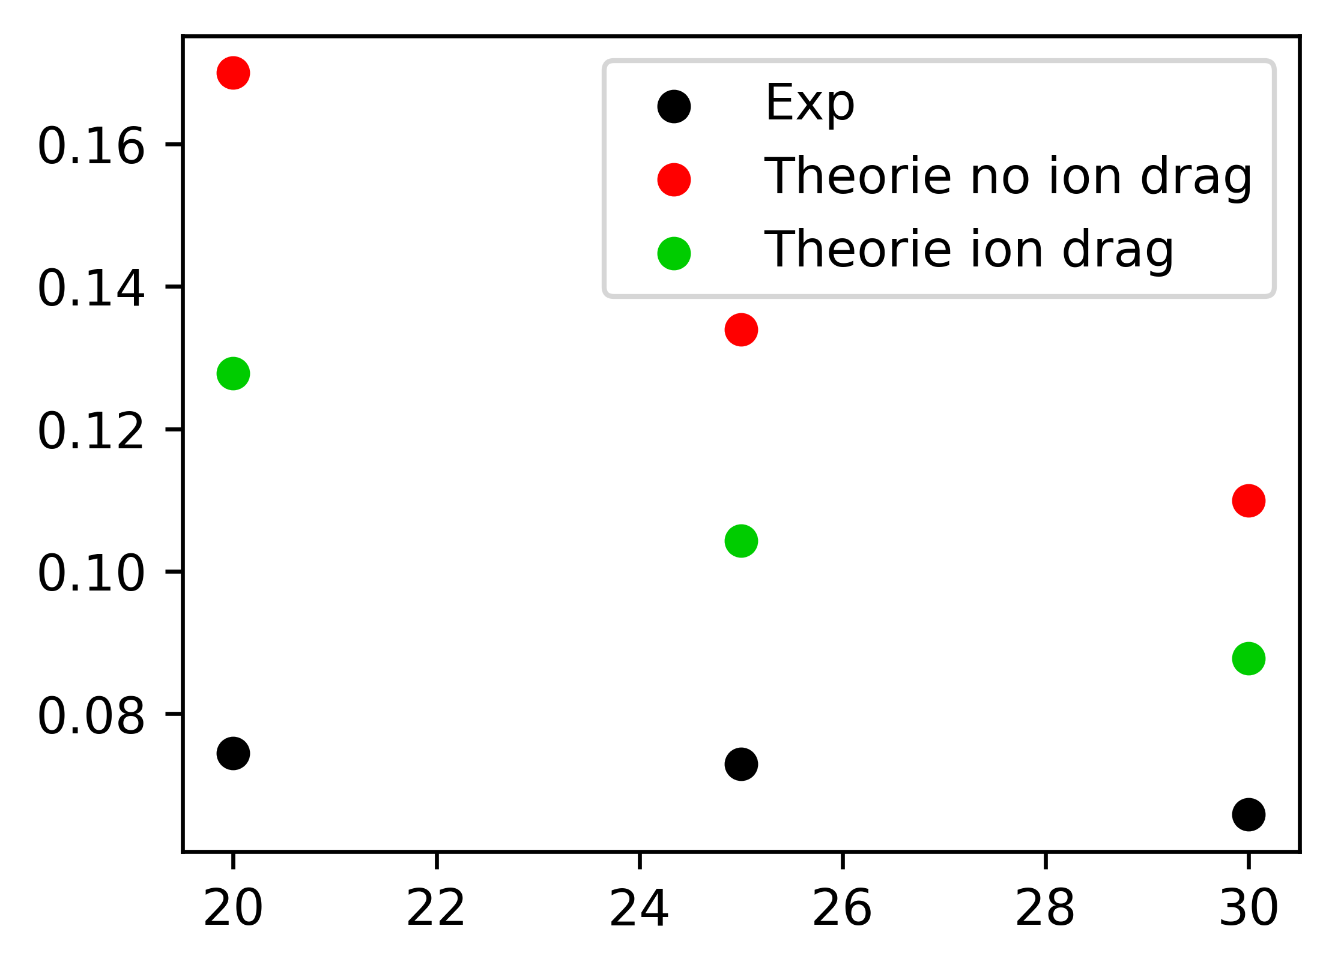
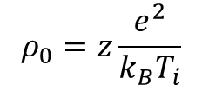
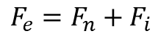
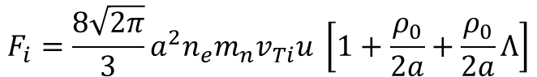
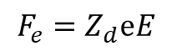
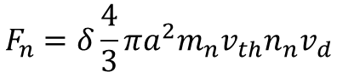
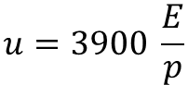
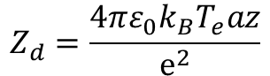
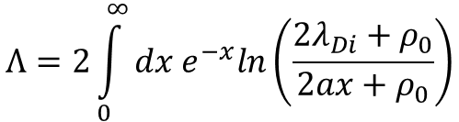
Theoretical Group Velocity
Khrapak et. al.
$$F_{e}=F_{n}+F_{i}$$
$$F_{e}=Z_{d}ⅇE$$
Z=0.345
$$F_{n}=δ\frac{4}{3}πa^{2}m_{n}v_{th}n_{n}v_{d}$$
$$F_{i}=\frac{8\sqrt{2π}}{3}a^{2}n_{e}m_{n}v_{Ti}u \left[1+\frac{ρ_{0}}{2a}+\frac{ρ_{0}}{2a}Λ\right]$$
$$ρ_{0}=z\frac{e^{2}}{k_{B}T_{i}}$$
$$Λ=2\int_{0}^{∞}{dx e^{−x}ln\left(\frac{2λ_{Di}+ρ_{0}}{2ax+ρ_{0}}\right)}$$
$$u=3900 \frac{E}{p}$$
$$Z_{d}=\frac{4πε_{0}k_{B}T_{e}az}{ⅇ^{2}}$$

Slide 9
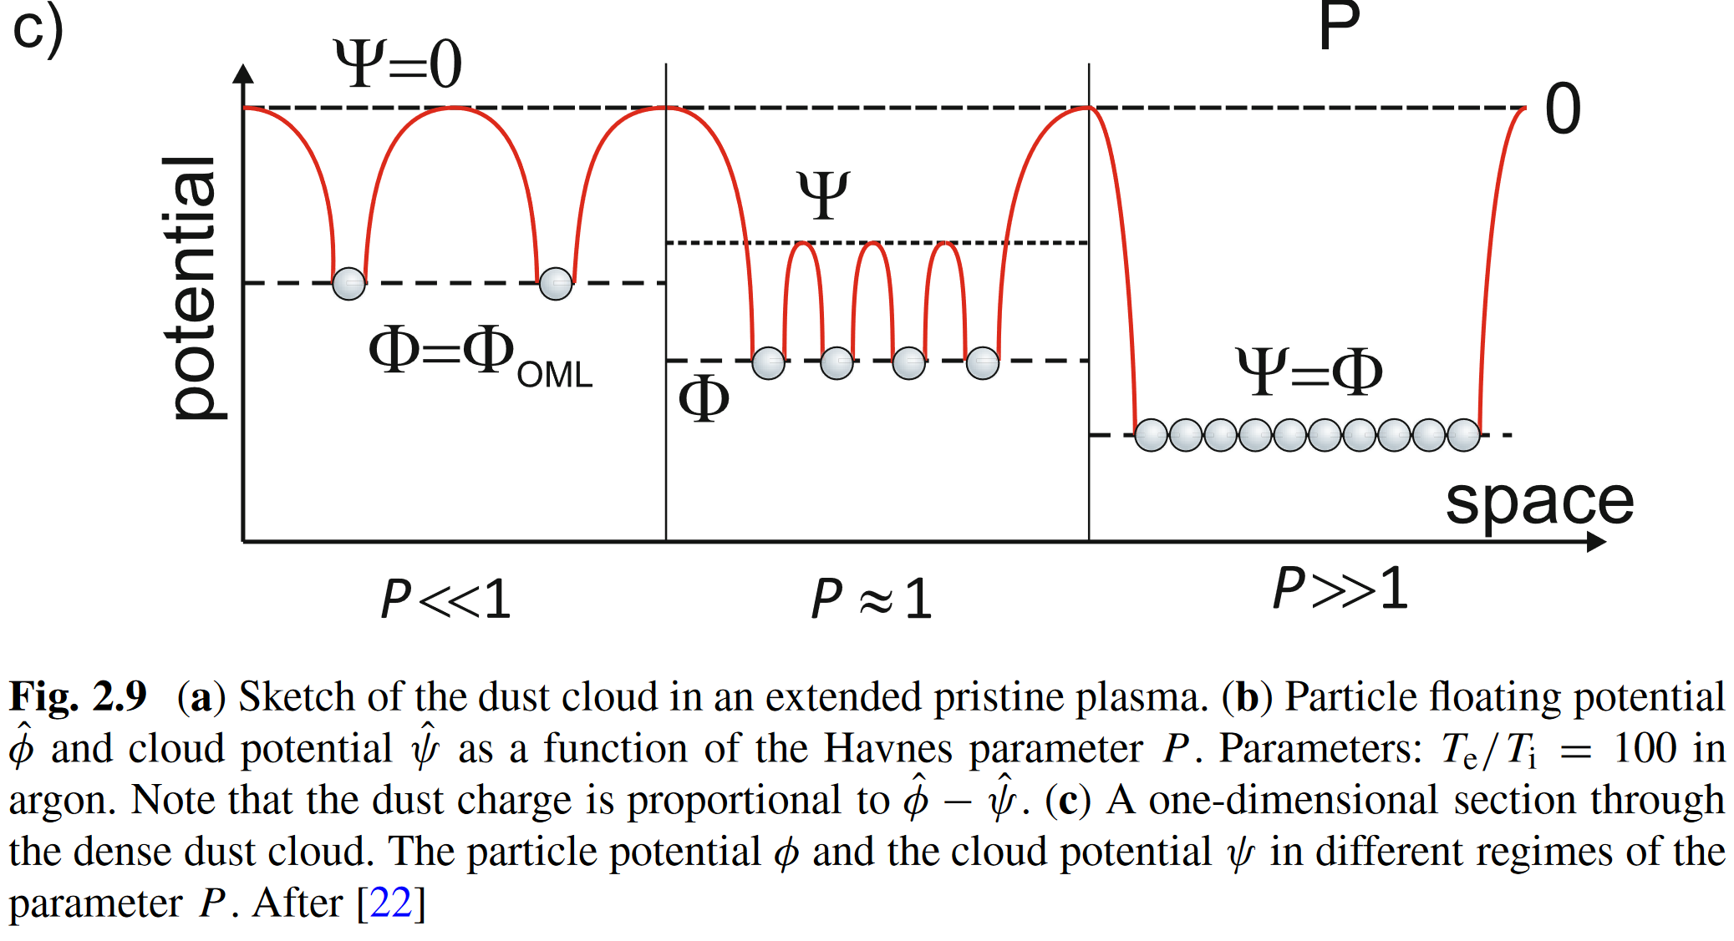
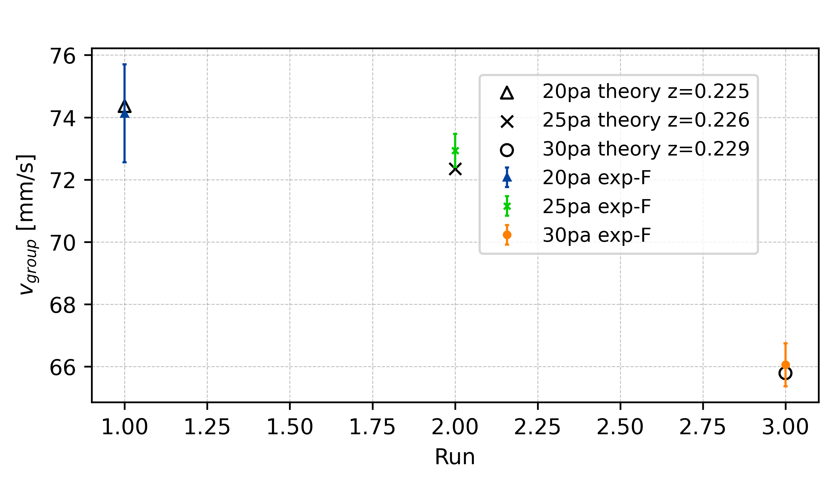
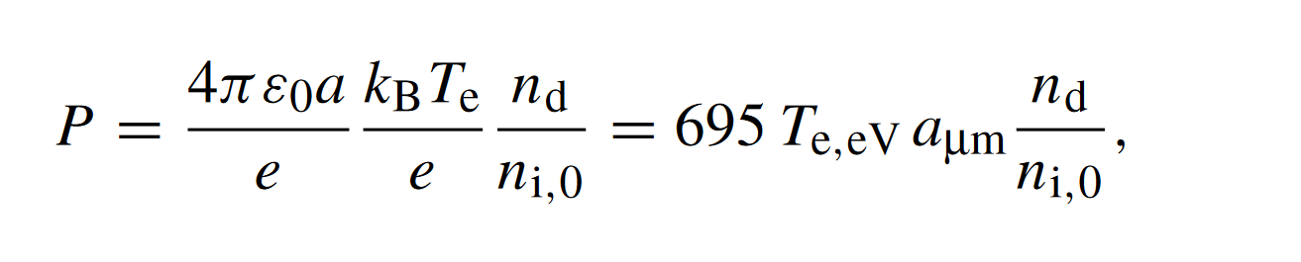
Charge Depletion – Havnes Parameter
[20Pa, 25Pa, 30Pa]
[2.047, 1.967, 1.899, 1.838]
New z from depletion theory

Slide 10
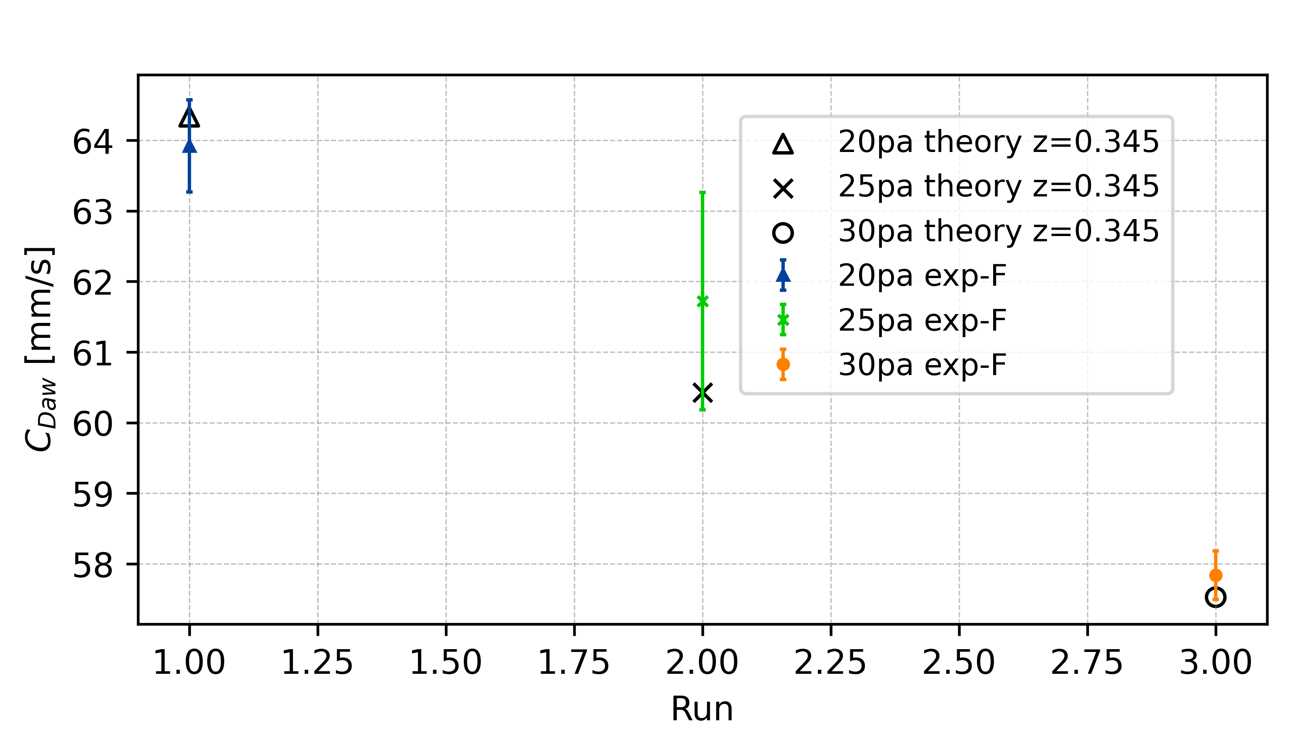
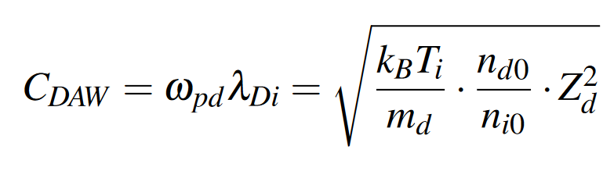
Dust-accoustic wave phase speed – C_{DAW}
Charge depletion is not playing a role in wave propagation
Charge reduction of individual particle is trigger effect of collective wave phenomena

Slide 11
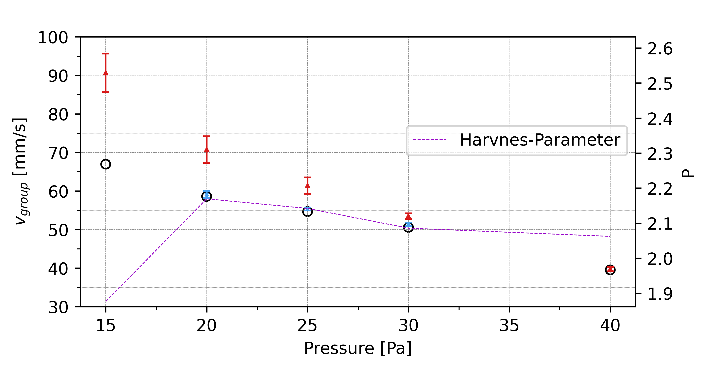
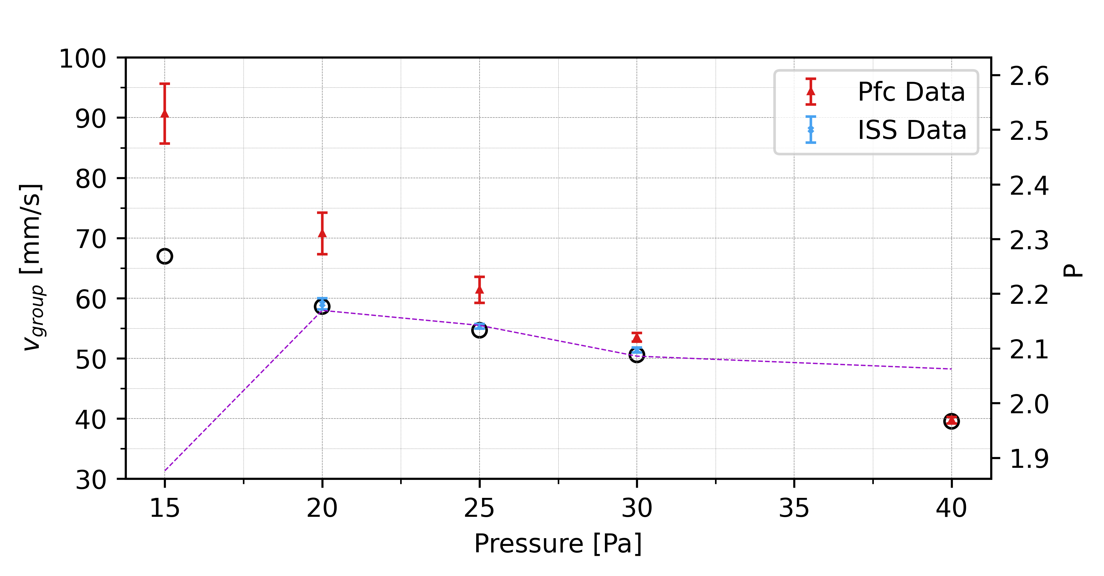
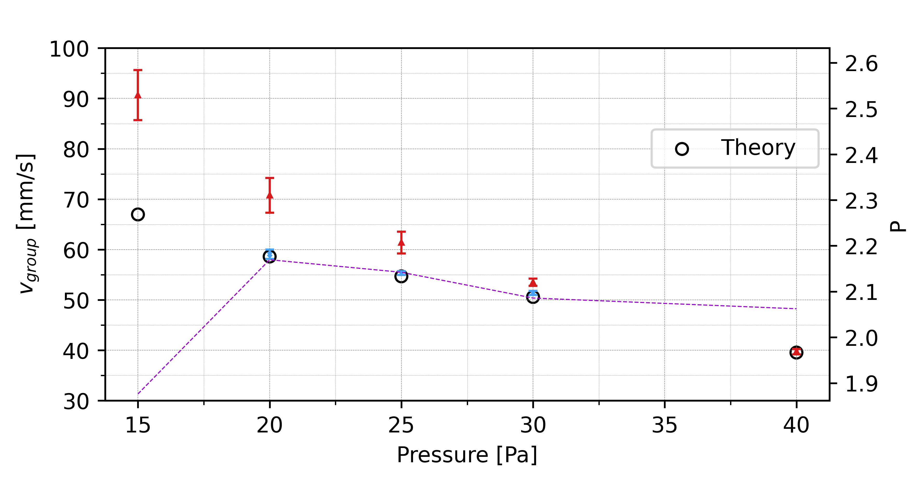

Slide 12
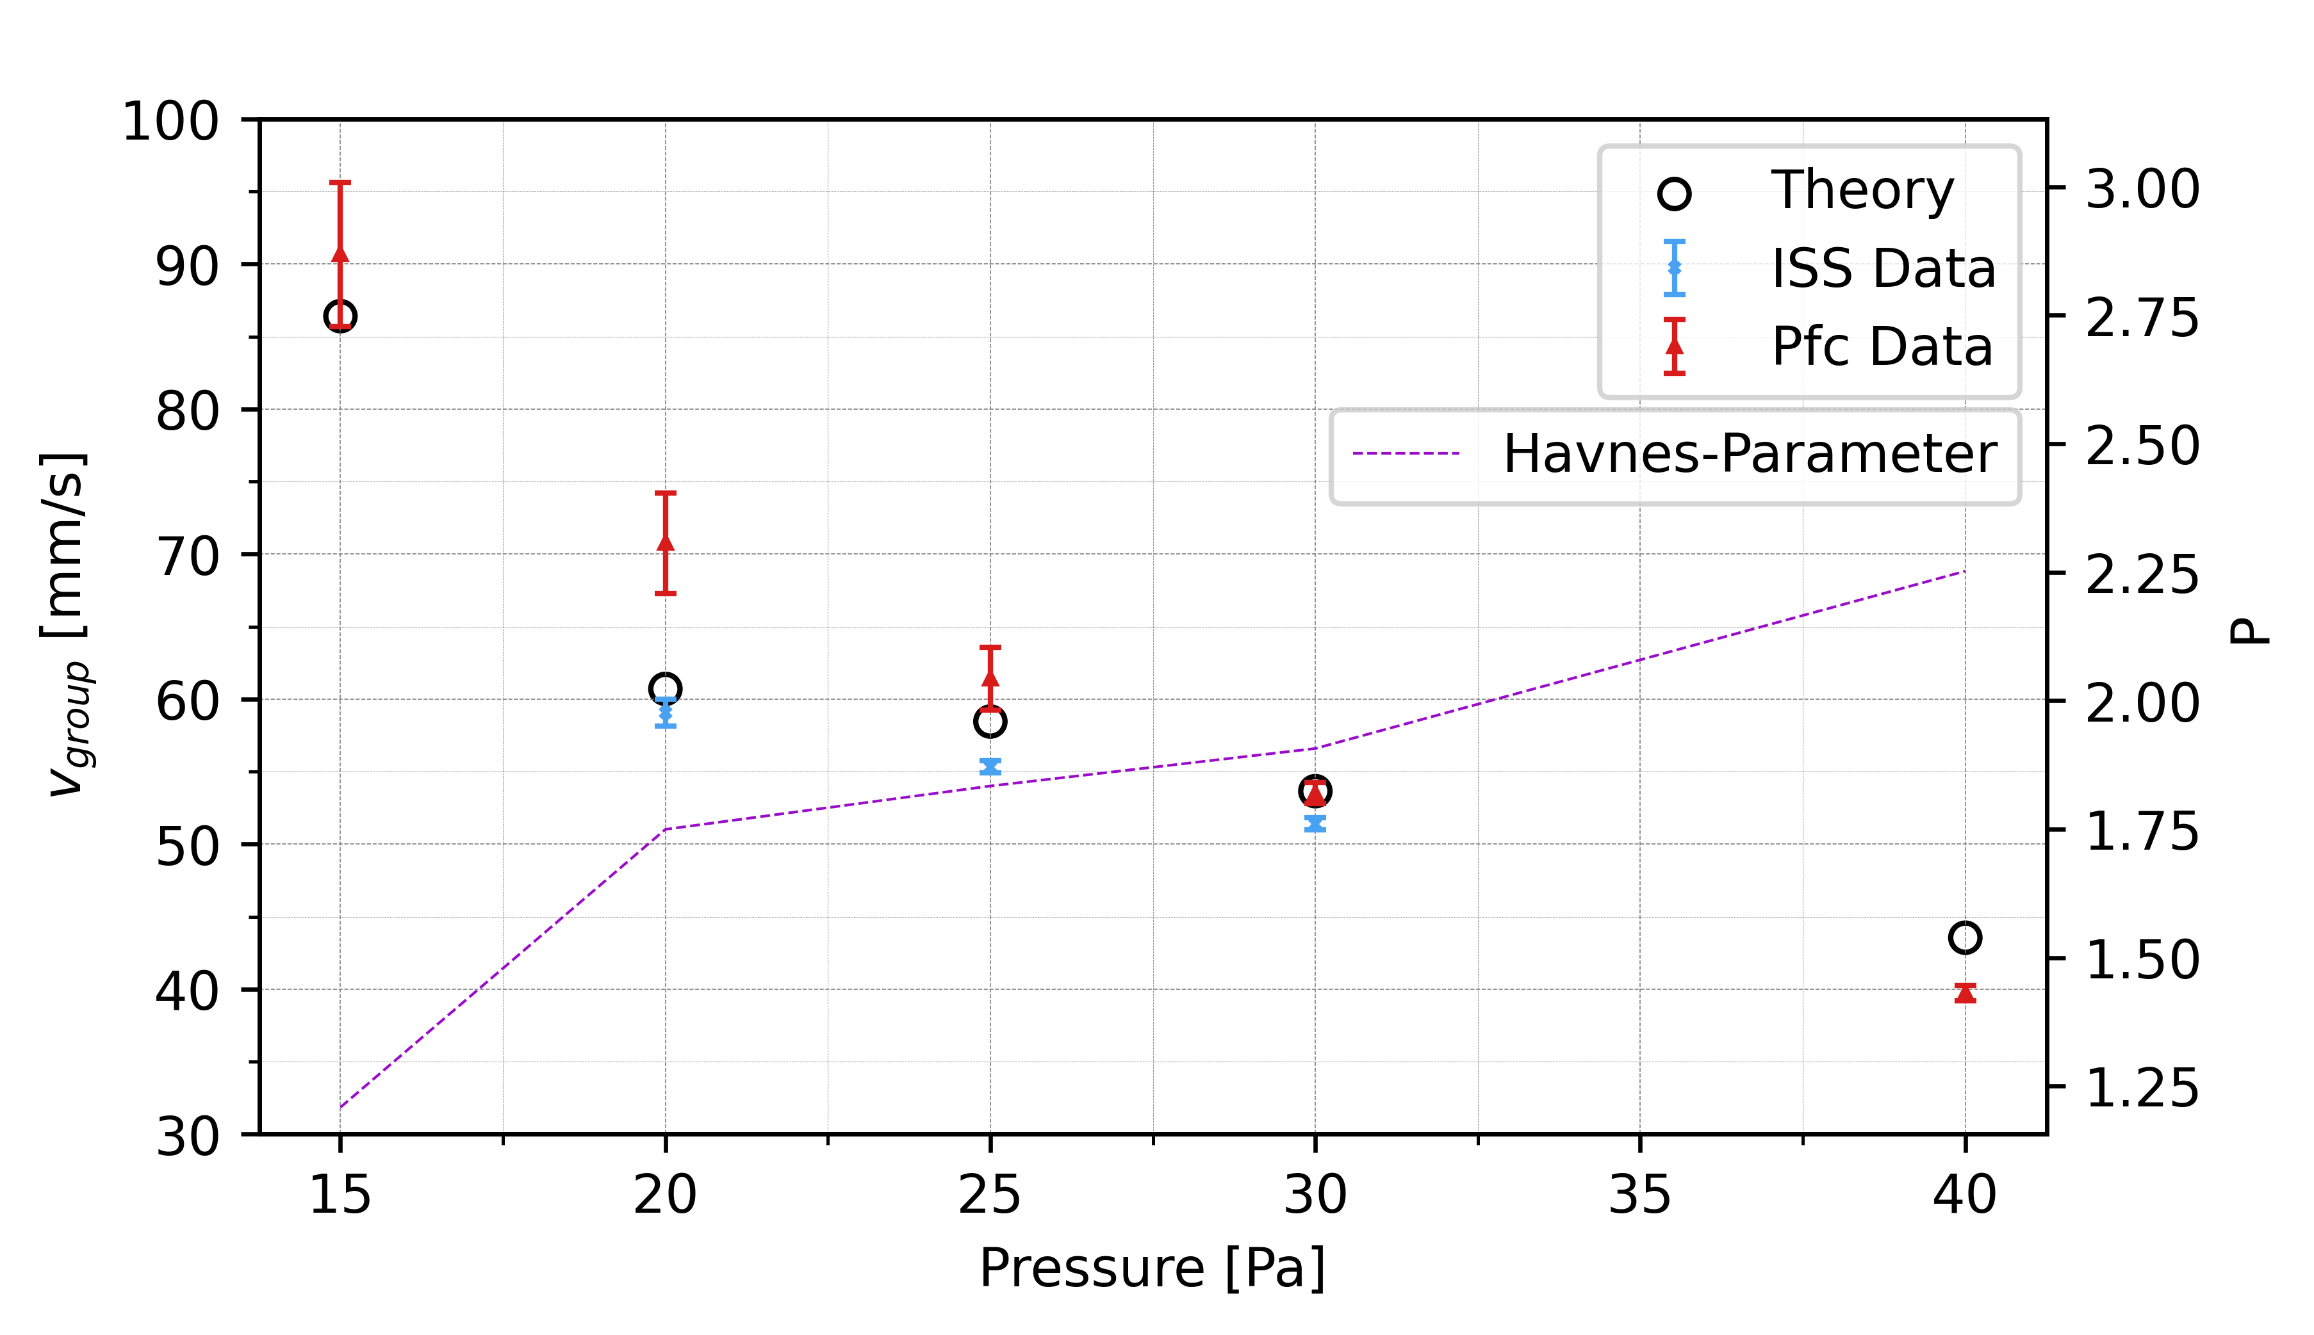
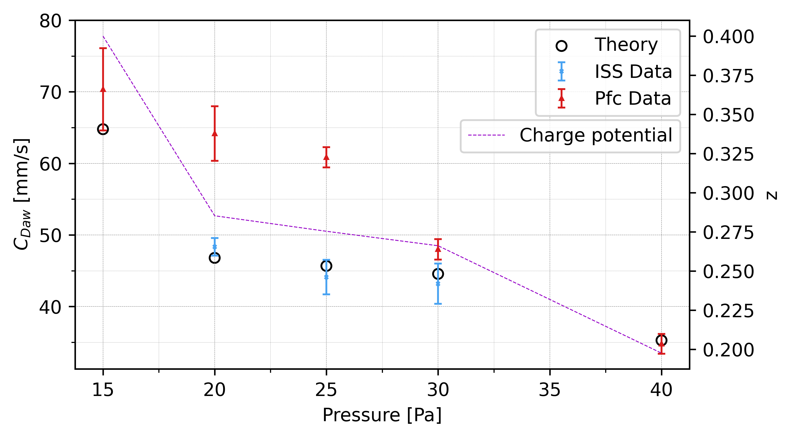

Slide 14
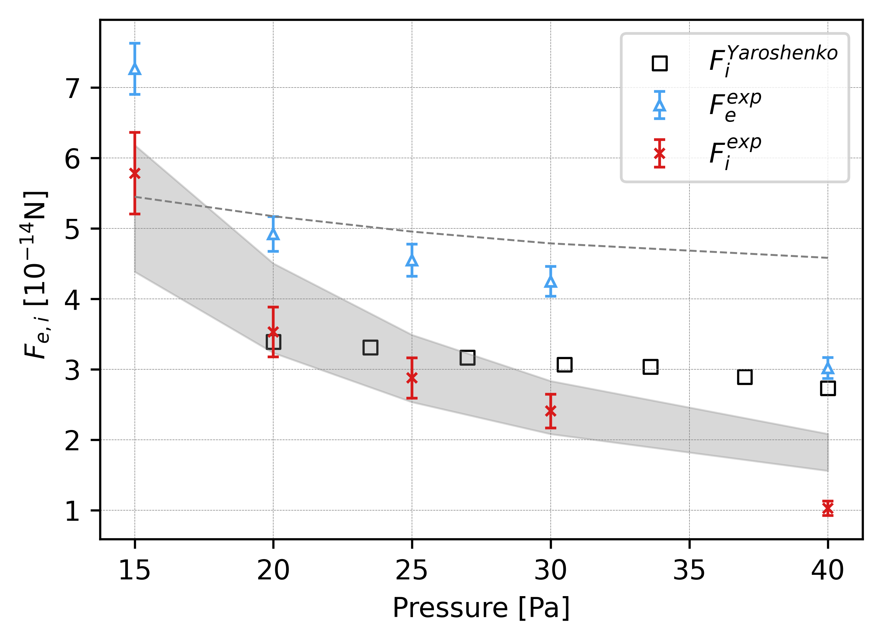
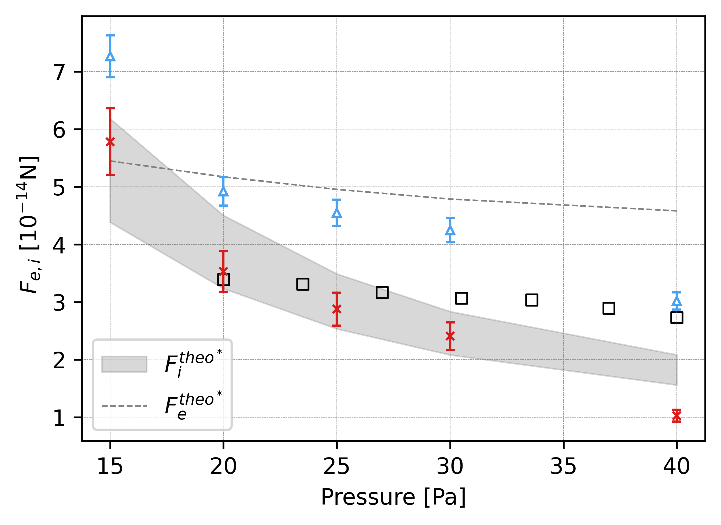

Slide 15
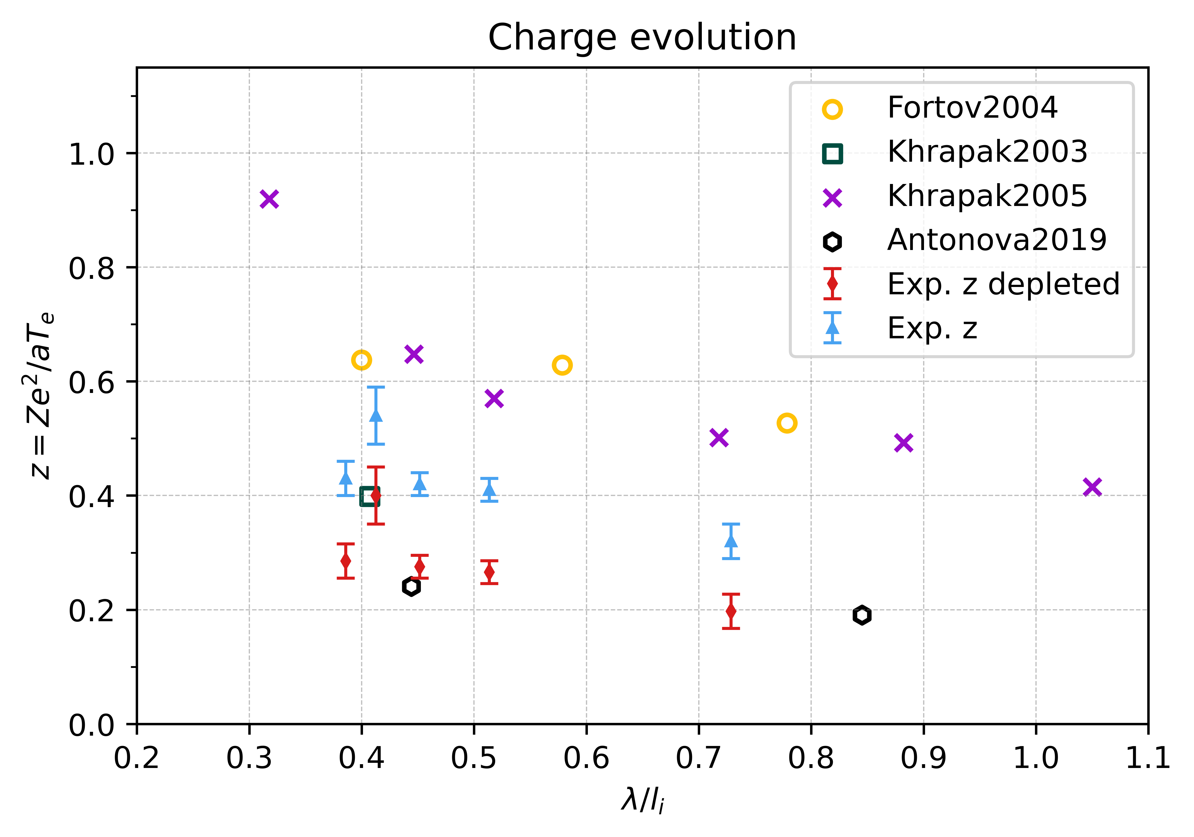
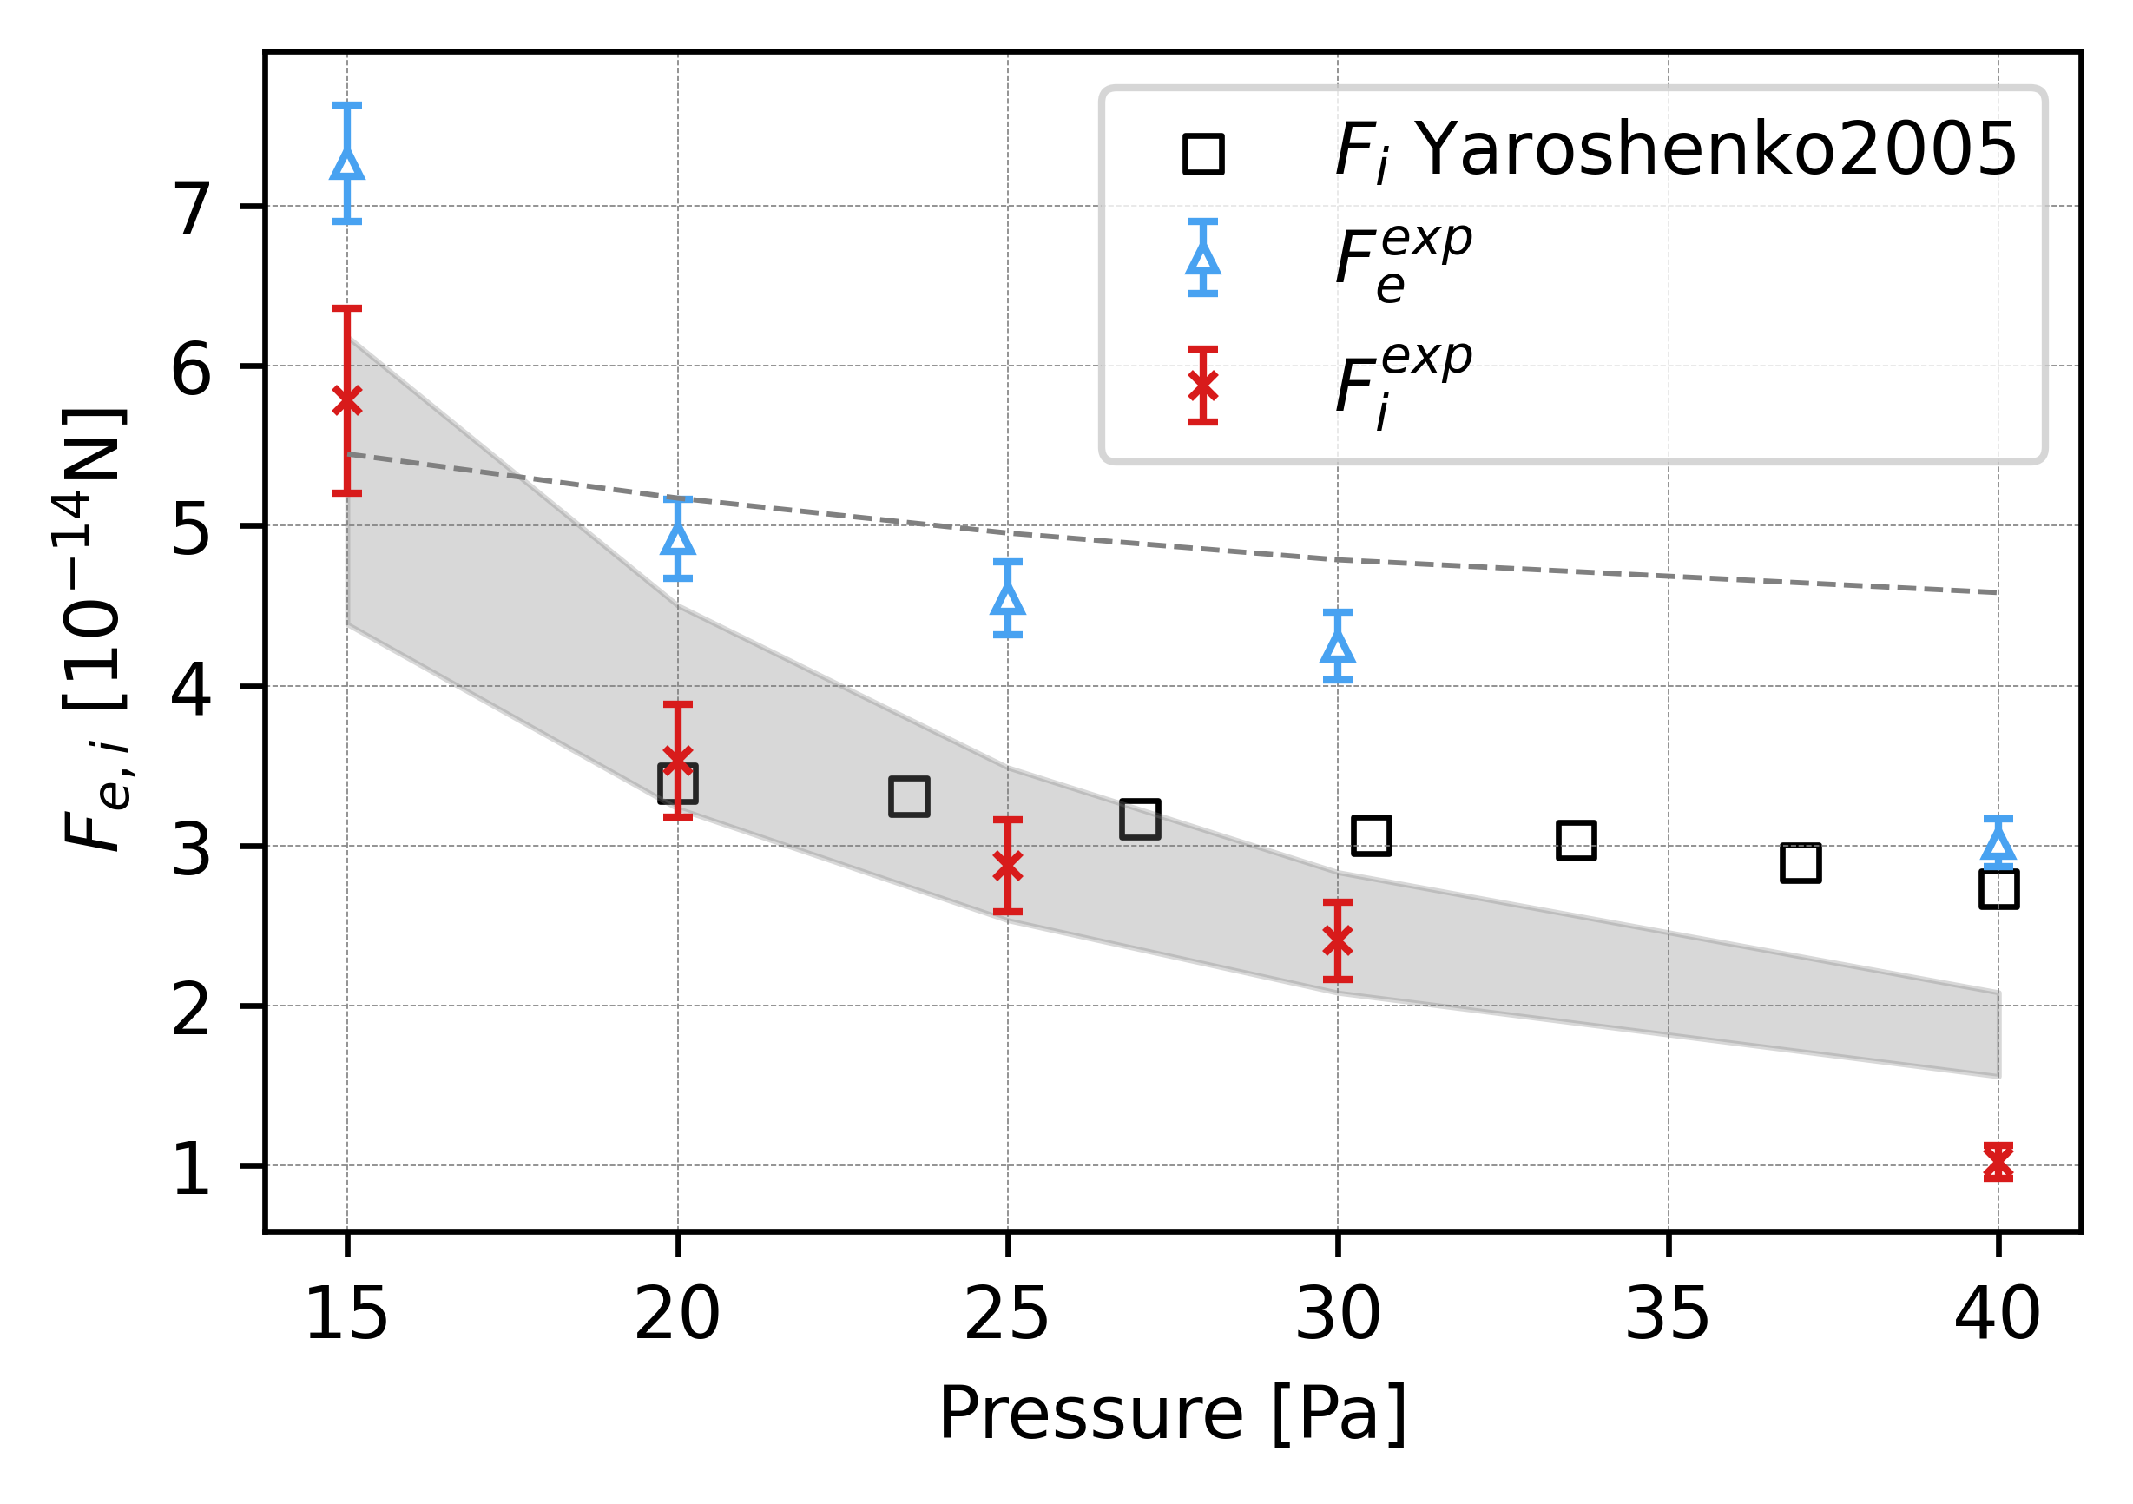

Slide 16
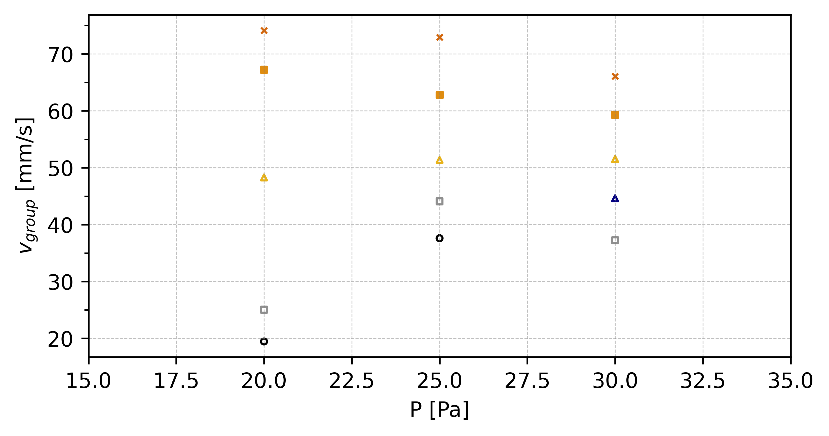
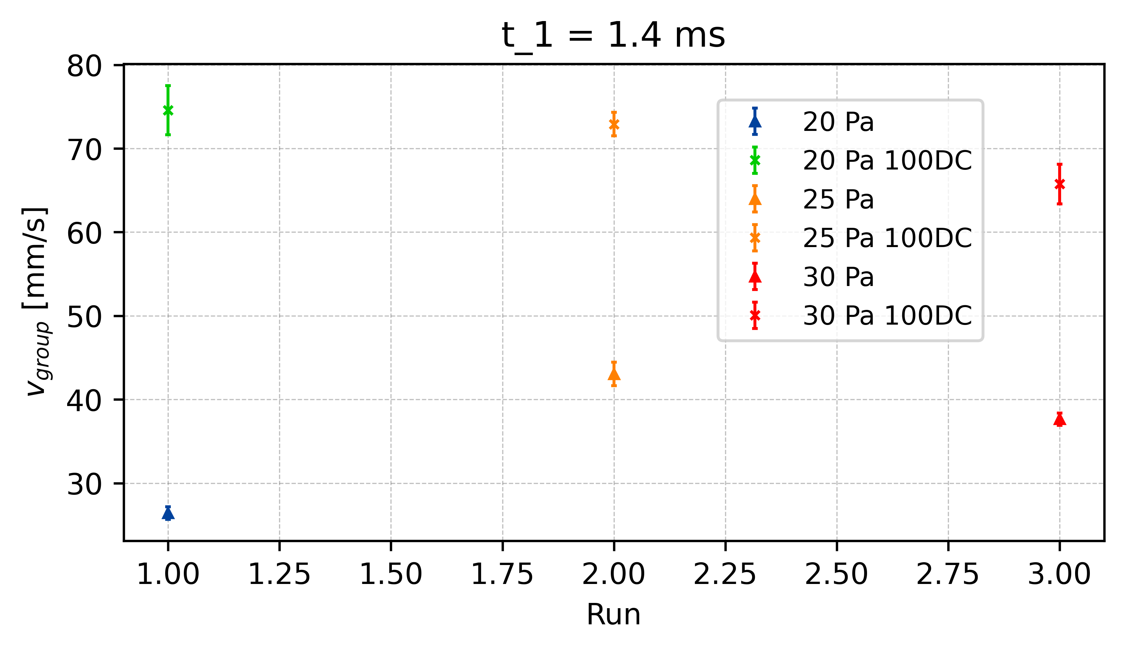
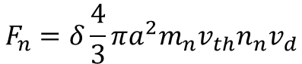
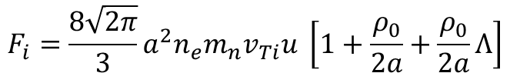
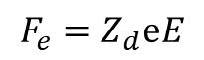
Reduction of Electric Field - v_{group}
t = 1.3ms
E_{effectiv} = 30%
100%
t = 1.4ms
E_{effectiv} = 40%
t1.4
80%
t = 1.5ms
E_{effectiv} = 50%
60%
t1.4
∆v_{25_t1.4}
t1.4
50%
∆v_{20_t1.4}
∆v_{30_t1.4}
$$F_{e}=Z_{d}ⅇE$$
40%
x E_eff
30%
$$F_{n}=δ\frac{4}{3}πa^{2}m_{n}v_{th}n_{n}v_{d}$$
$$F_{i}=\frac{8\sqrt{2π}}{3}a^{2}n_{e}m_{n}v_{Ti}u \left[1+\frac{ρ_{0}}{2a}+\frac{ρ_{0}}{2a}Λ\right]$$
x E_eff
x E_eff
Vergleiche: V_g vs P und V_g vs E

Slide 17
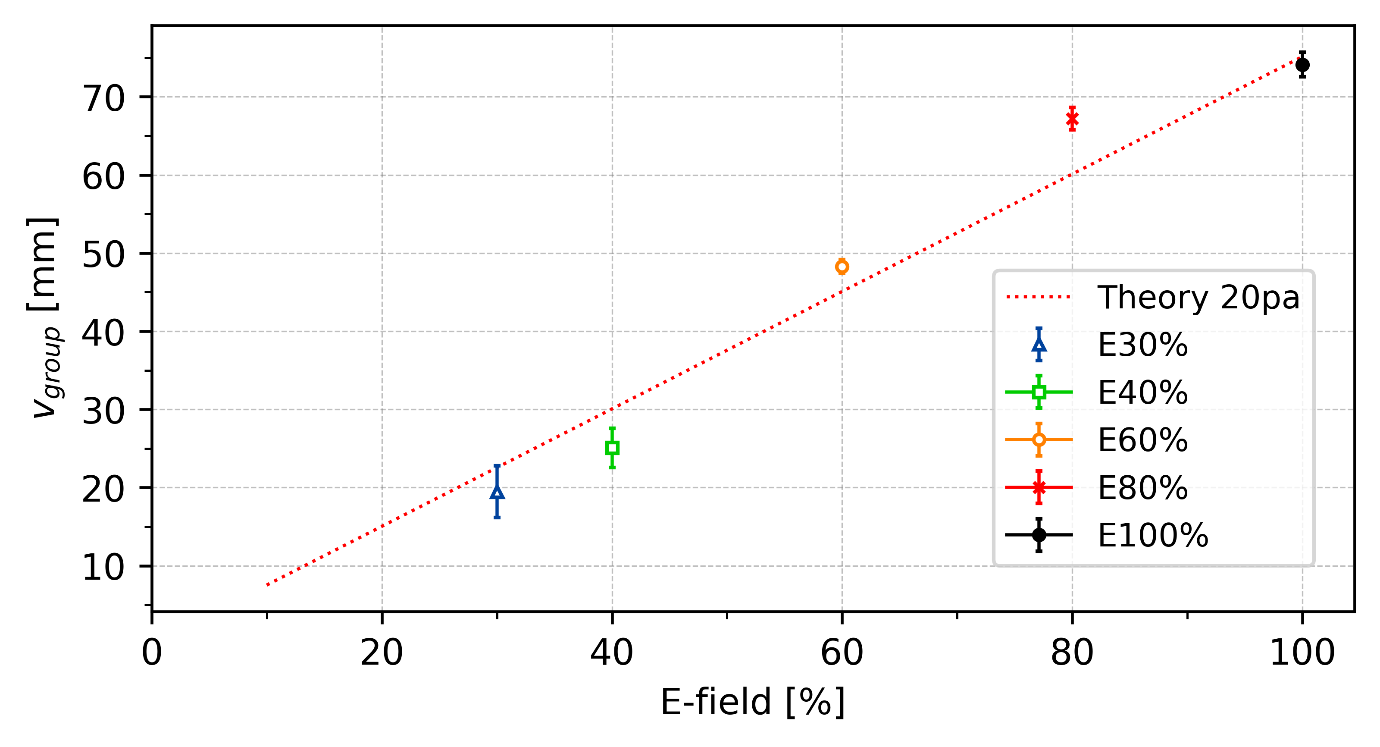
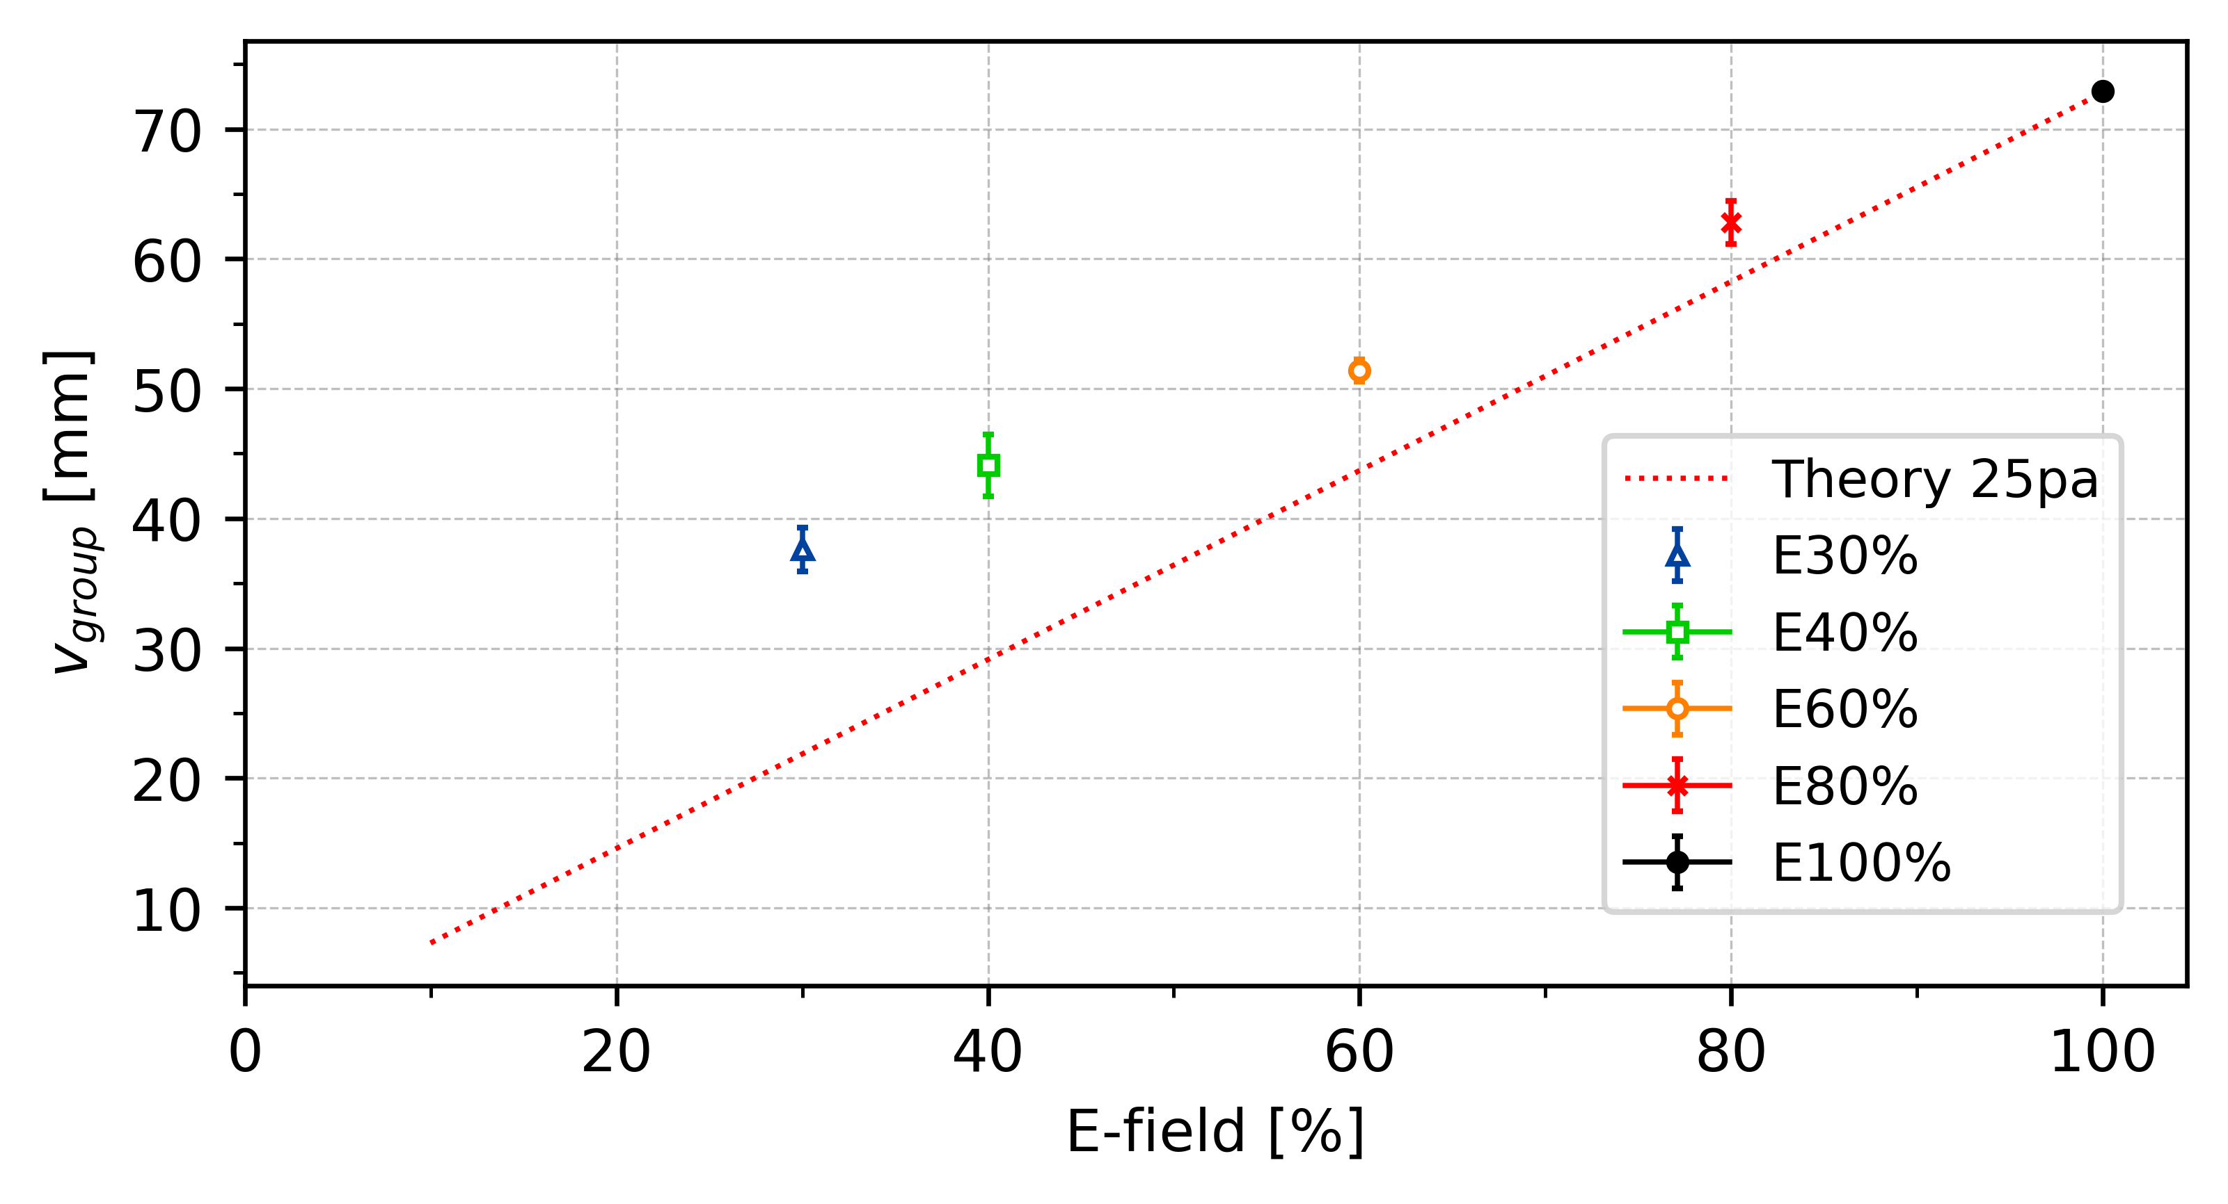
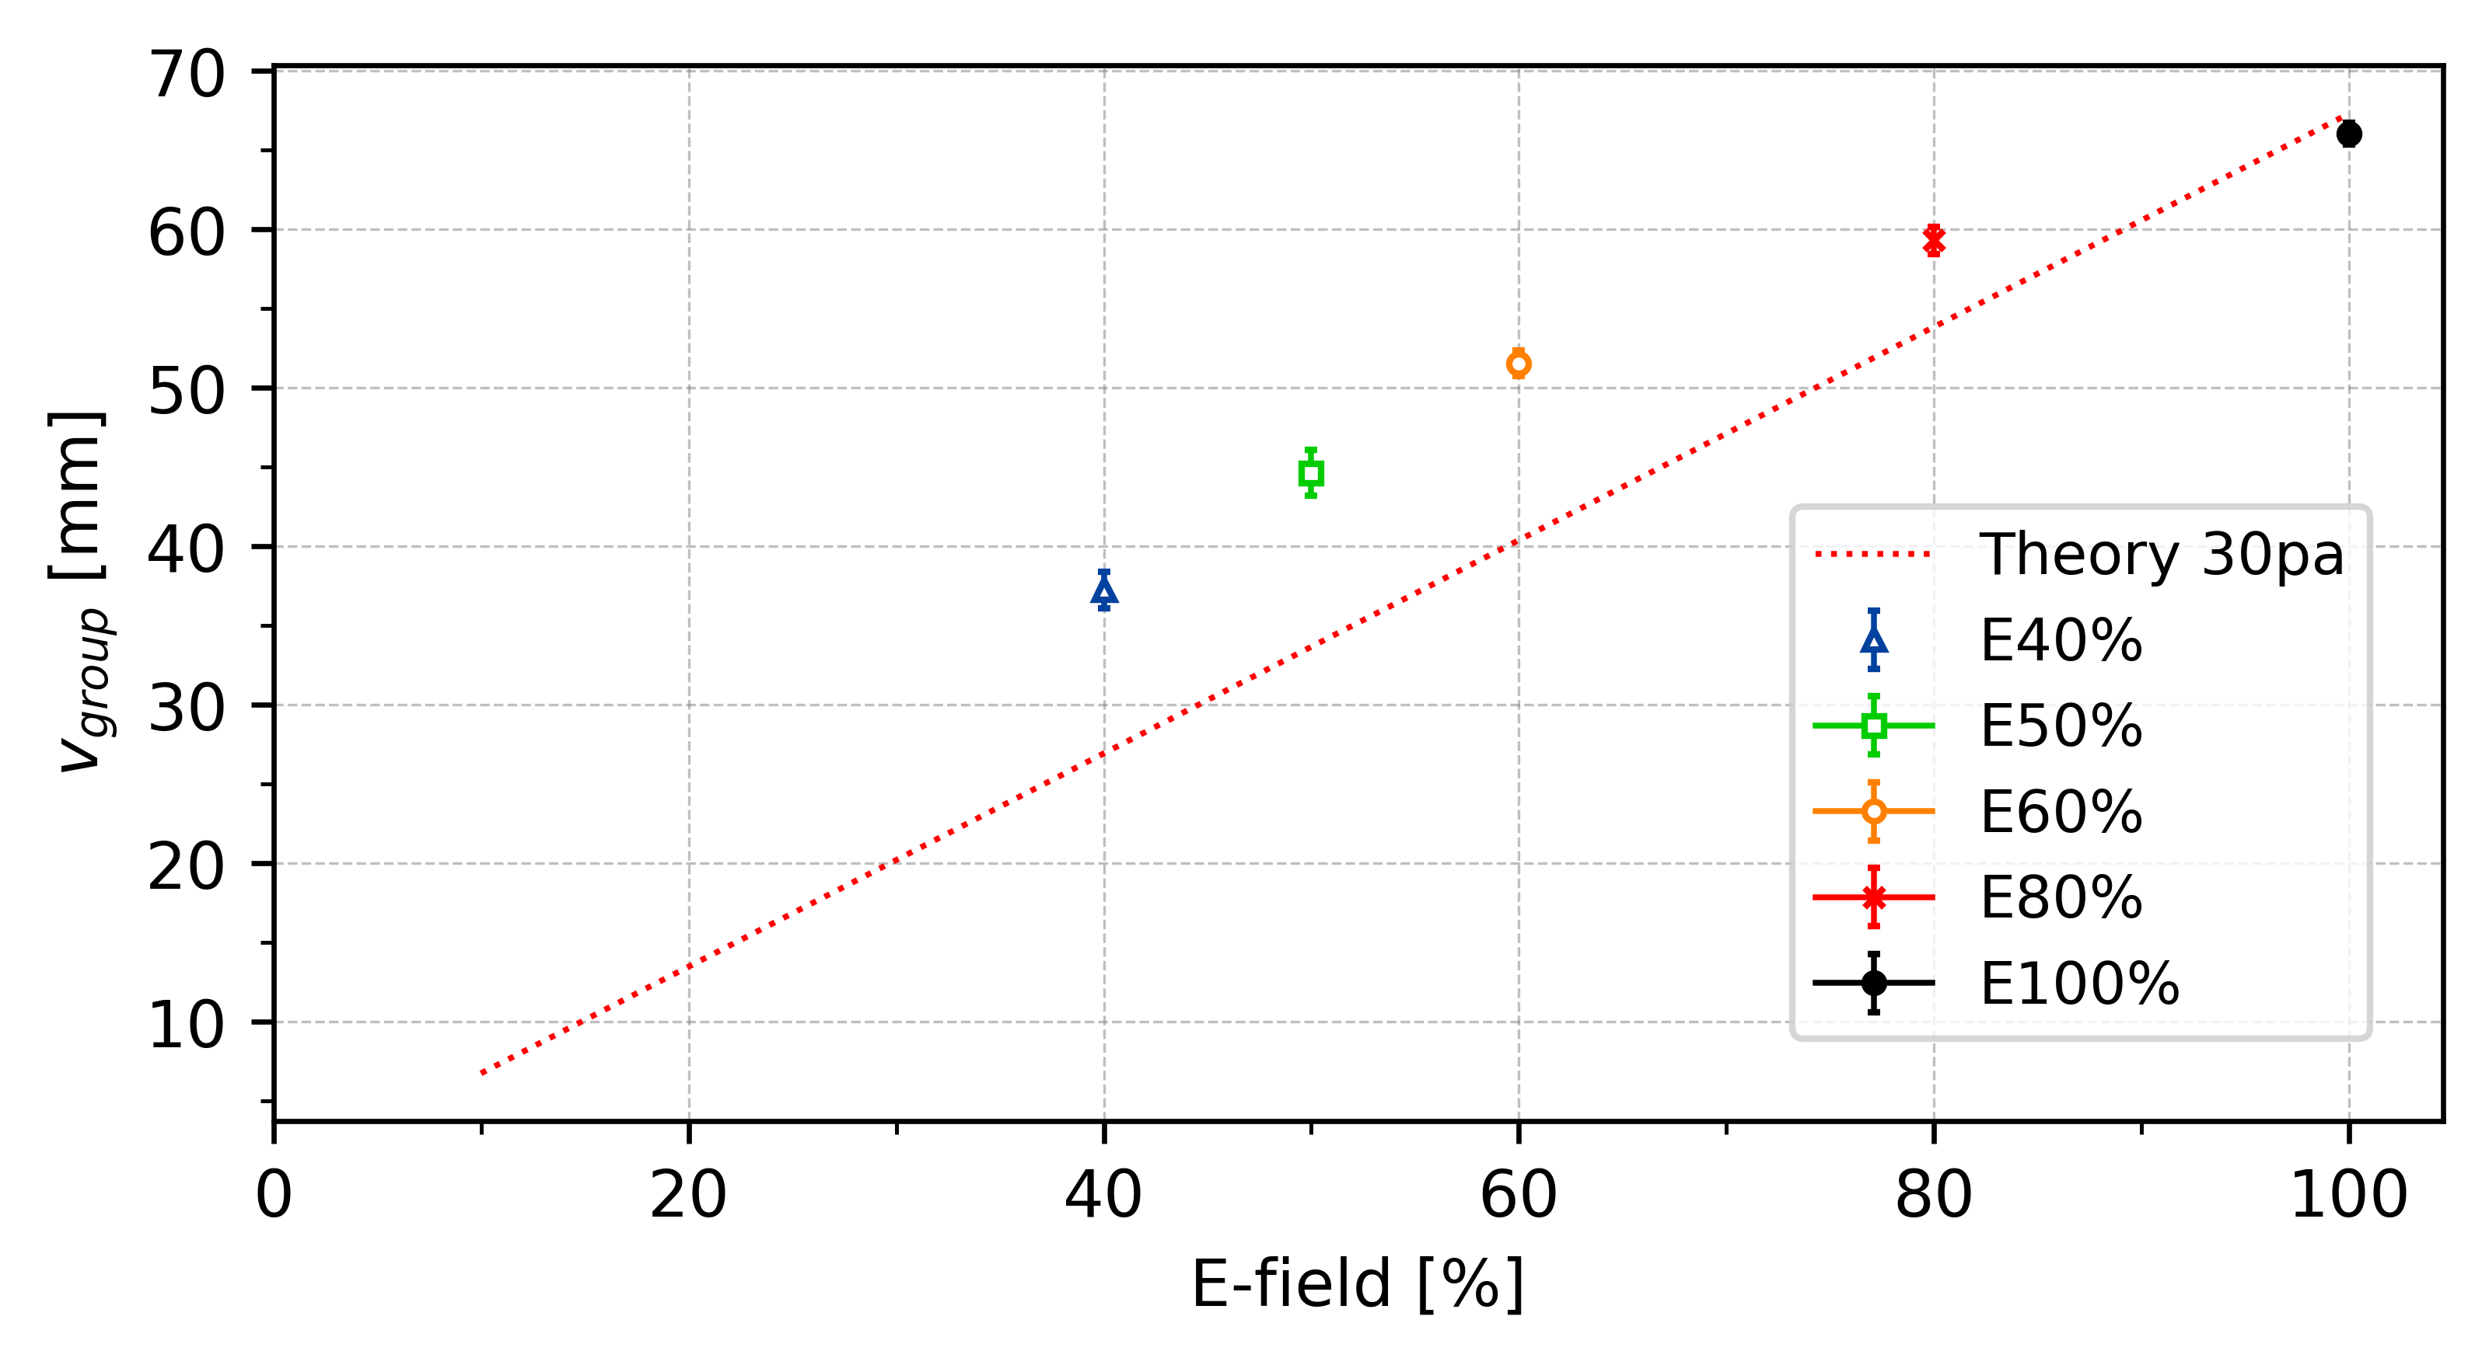
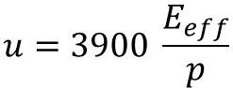
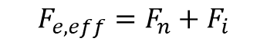
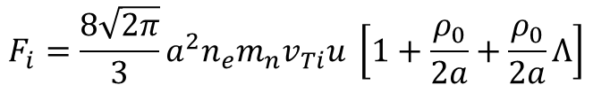
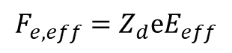
Reduction of Electric Field - v_{group}
. . .
t = 1.3ms
E_{eff} = 30%
$$F_{e,eff}=F_{n}+F_{i}$$
t = 1.4ms
E_{eff} = 40%
$$F_{e,eff}=Z_{d}ⅇE_{eff}$$
t = 1.5ms
E_{eff} = 50%
. . .
$$F_{i}=\frac{8\sqrt{2π}}{3}a^{2}n_{e}m_{n}v_{Ti}u \left[1+\frac{ρ_{0}}{2a}+\frac{ρ_{0}}{2a}Λ\right]$$
$$u=3900 \frac{E_{eff}}{p}$$
Modified frost formular?

Slide 18
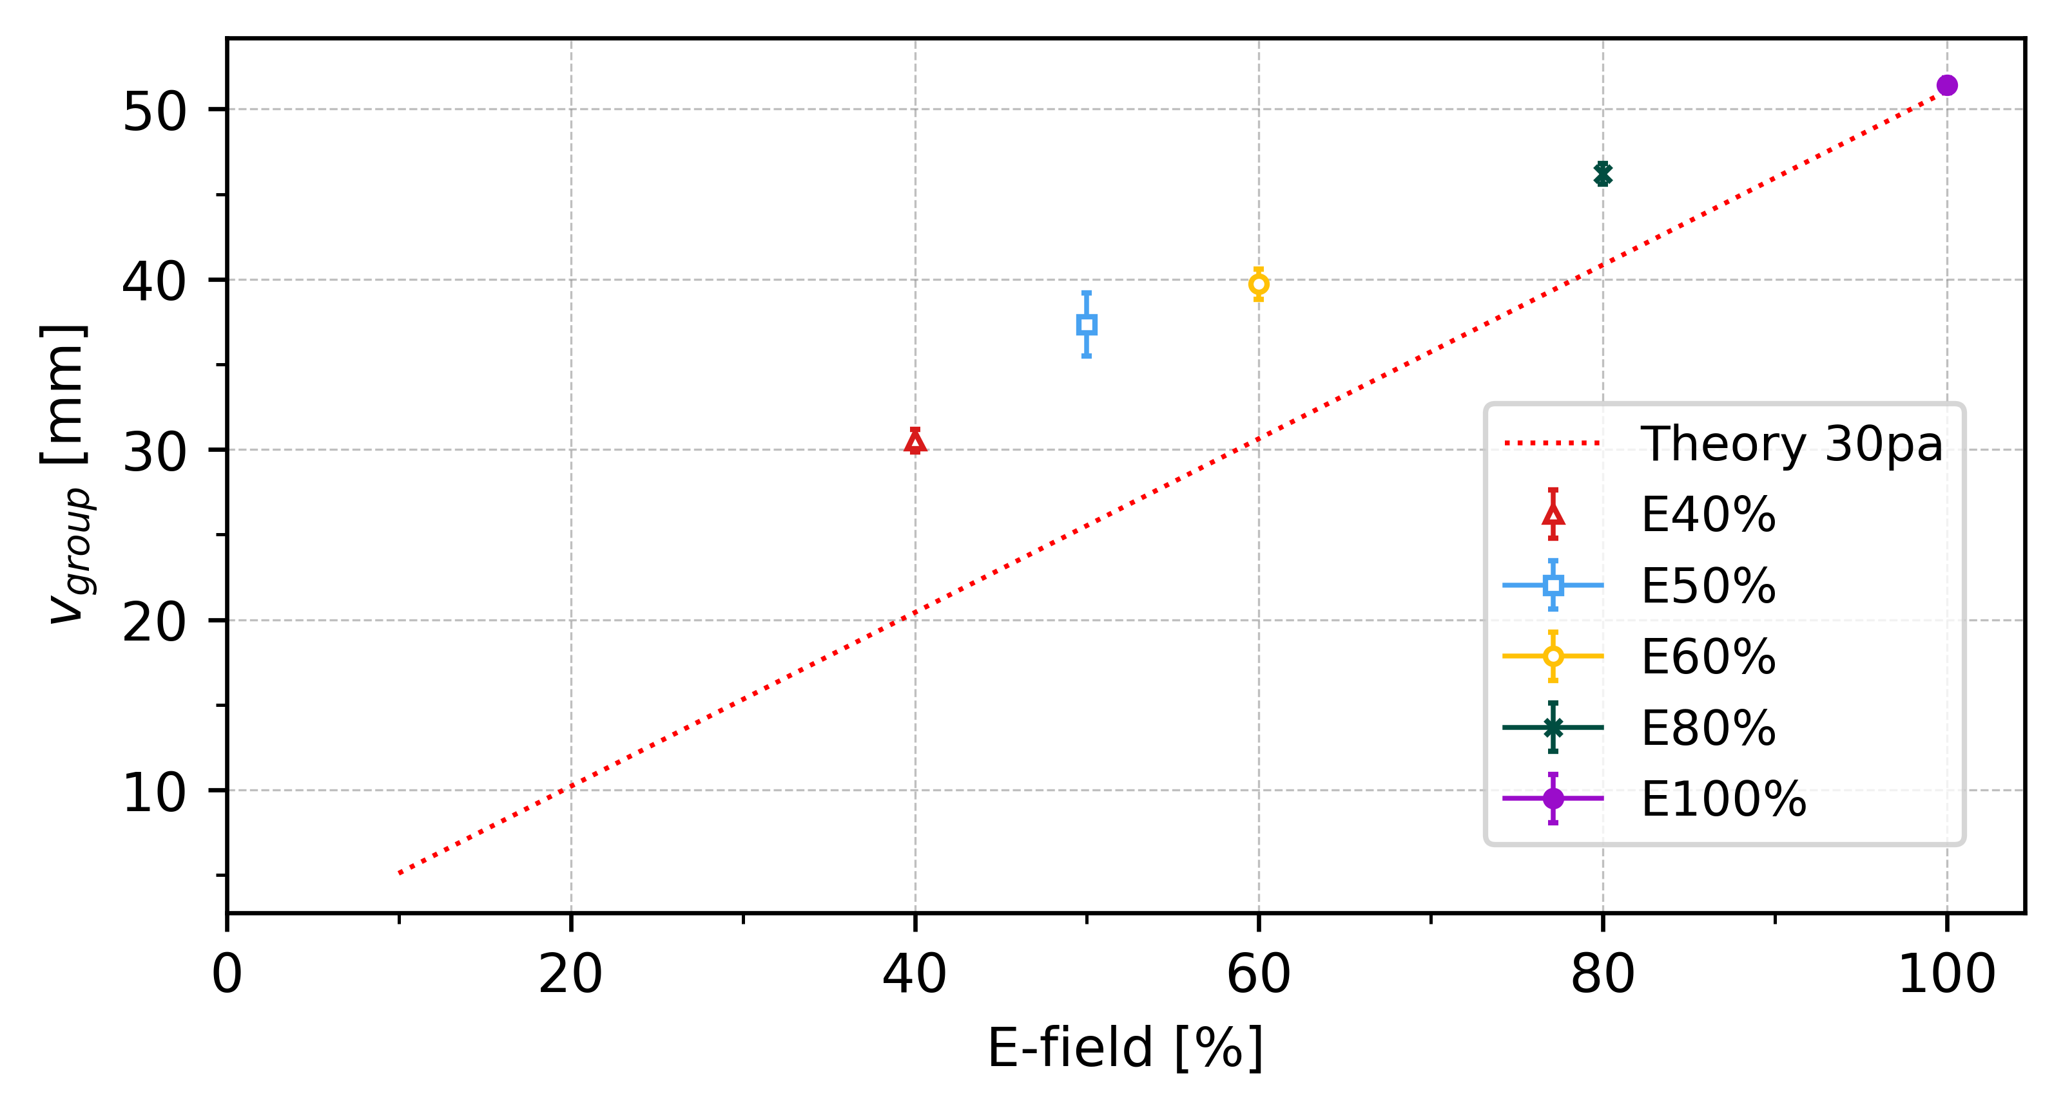
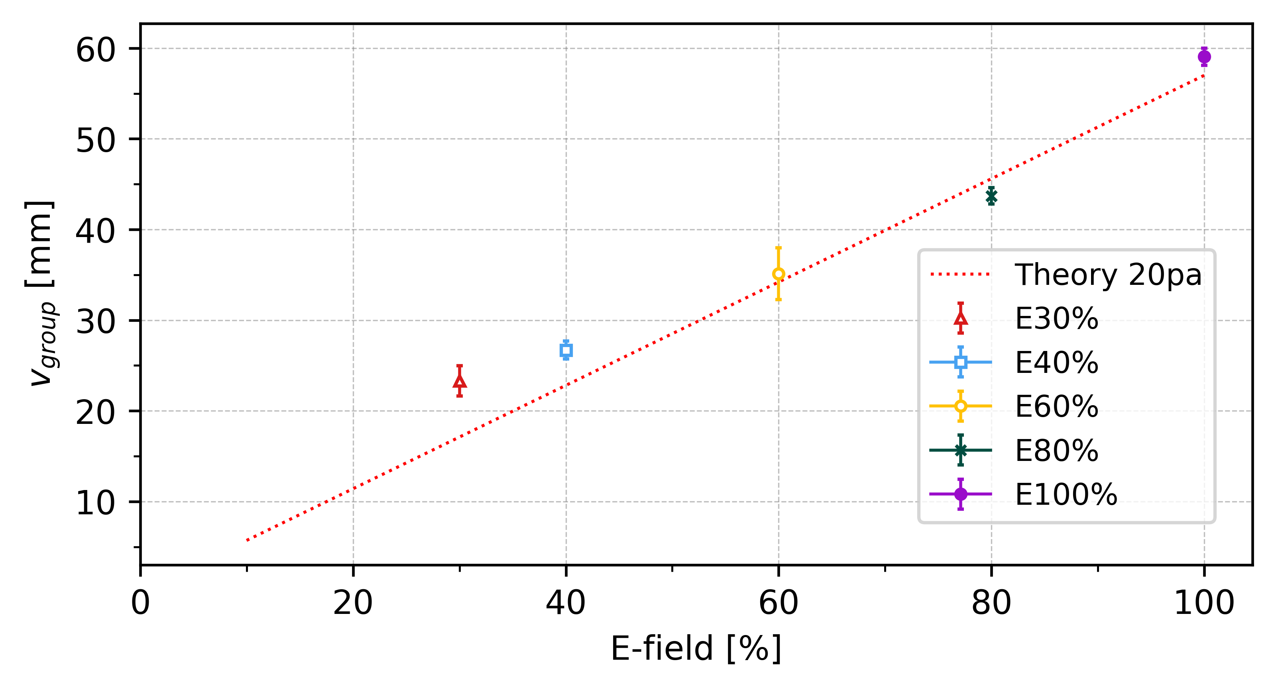


Slide 19


Reduction of Electric Field - C_{DAW}
t = 1.4ms
E_{effectiv} = 40%

Slide 20



Reduction of Electric Field - C_{DAW}
*E_eff[%]
Or ?
*E_eff[%]

Slide 21




Slide 22



Slide 23



Slide 24



Slide 25



Slide 26

Critical Electric Field - C_{DAW}
Pressure | C_Forward | E-field Forward | E-crit
20
20
25
25
30
30

Slide 27
Appendix

Slide 28


Polarity Difference
Average
∆c_20 = 11.0 mm/s ~ 14.5%
∆c_25 = 13.5 mm/s ~ 17.8%
∆c_30 = 7.8 mm/s ~ 11.9%
∆c_20
∆c_25
∆c_30

Slide 29


∆c_30 = 8.5 mm/s ~ 17.0%

Slide 30




Slide 31


-
∆c_25
∆c_30
∆c_20 = 4.5 mm/s ~ 14.5%
∆c_25 = 7.5 mm/s ~ 15.5%
∆c_30 = 6.9 mm/s ~ 15.5%
∆c_20

Slide 32

331 = 3,9058 mm
10 f = 0,16 sec
24,3 mm/s

